Slide 1


Year 8 Curriculum Booklet
St Aloysius’ College
2021/2022

Slide 2
Contents Page
Introduction | 2
Art | 4
Computer Science | 5
Design and Technology | 6
English | 7
Geography | 8
History | 9
Mathematics | 10
Modern Foreign Languages (French) | 11
Modern Foreign Languages (Spanish) | 12
Music | 13
PE | 14
Religious Education | 15
Science | 16
Assessment & Revision | 17
Leaning Apps | 18
Go4Schools | 19
1

Slide 3
Introduction
Welcome to our Curriculum Evening. Thank you for attending this important evening.
Tonight, is all about your child and how the St Aloysius’ College community can make further impact on your sons’ personal, social and educational journey to their GCSE exams and beyond. This evening will accomplish three important aims for you and your son:
• To further develop and build on a positive and supportive relationship between parents, students and staff.
• To support you, the parent with information that will enable you to ensure that your son achieves the academic outcomes that he is capable off.
• To continue to nurture aspiration in your son so that he can make effective decisions when it comes to his education
We are here for you and your son’s education and to use this partnership to work closely together to ensure all avenues of success are taken full advantage of between now and the time your son leaves education at St Aloysius’ College.
This booklet contains information on subject curricula and more information that will be communicated this evening.
Should you require any additional assistance or support at any time, please do not hesitate to contact your son’s Head of Year.
S Kisten
Assistant Headteacher – Curriculum & Outcomes
2

Slide 4
Introduction
Dear Parent/Carer,
As your son enters Year 8 we hope that he has settled well at St Aloysius’ College and is confident in his secondary education subjects. During the Spring Term your son will be asked to select his GCSE subjects and we ask that, together with your son, you consider which subjects he enjoys and achieves well in.
This booklet and evening is designed to raise your awareness of work and events in relation to Year 8. It is important that you are informed so that you are in a position to support your child as they negotiate their time at school and adjust to this transition period.
The evening and booklet will provide an opportunity for us to inform you of key Year 8 information including:
  Curriculum Structure
  Measuring Academic Progress, including Reports
  School & Home Support Strategies
  Target Setting
  Landmark Assessments
  Homework
If there are any topics on which you feel you need more information, please do not hesitate to contact us.
We do hope you enjoy the evening and find this booklet useful.
Thank you for your continued support.
Yours sincerely,
Dr Ali Khan
Head of Year 8
3

Slide 5
Art
Year 8
Head of Department: Mr L. Northey
 | Autumn 1 | Autumn 2
Focus/Context for Learning | Week: Drawing for FORM and TONE pencil Drawing for FORM – paint. Drawing for COLOUR and PATTERN oil pastels – natural forms. Drawing for COLOUR and PATTERN water colour – Leaves & Shells Investigate work of artists using Natural Form e.g. William Morris Test/afl: Peer and self-assessment Enrichment | Week: Investigate Pattern/ natural forms. Develop repeat pattern based on observational drawings of leaves. Complete patterns using appropriate colourways. Study of Georgia O’Keeffe Study of Georgia O’Keeffe. Art Exam –AP1 Enrichment
 | Spring 1 | Spring 2
Focus/Context for Learning | Week: Coloured pencil/oil pastel study of Pop Art Designer Investigate Pop Artists’ use of food and drink imagery e.g. Warhol/Oldenburg Painting of design in Pop Art Style Continue to develop work Test/Afl: Peer and self-assessment Enrichment | Week: Research into Keith Haring Work inspired by Keith Haring Roy Lichtenstein – Pop artist. Development and experimentation with Text and images. Development and experimentation with Text and images. Final Piece Test/Afl: Peer and self-assessment Enrichment
 | Summer 1 | Summer 2
Focus/Context for Learning | Week: Artist Research: Sandra Chevier Proportions of the human face and practice drawing of individual features. Work created in style of Artist Continue to develop work in style of Artist Complete development of work in style of Artist Produce final piece | Week: Artist Research: Banksy Produce work in the style of the Artist Work created in style of Artist Complete development of work in style of Artist Produce a final piece Enrichment
4

Slide 6
Computer Science
Year 8
Lead Teacher: Mr N. Kakou
Computing and computer technology are part of just about everything that touches our lives from the cars we drive, to the movies we watch, to the ways businesses and governments deal with us. Understanding different dimensions of computing is part of the necessary skill set for an educated person in the 21st century. Whether one wants to be a scientist, develop the latest killer application, or just know what it really means when someone says 'the computer made a mistake', studying computing will provide you with valuable knowledge. Computing requires and develops capabilities in solving deep, multidimensional problems requiring imagination and sensitivity to a variety of concerns.
 | Autumn 1 | Autumn 2
Focus/Context for Learning | Introduction to Python (2) L1 Selection L2 Writing algorithms L3 While loops L4 Programming project | Algorithms L1 Computational thinking L2 Searching algorithms L3 Sorting algorithms L1 The CPU
 | Spring 1 | Spring 2
Focus/Context for Learning | A. Systems architecture L1 The CPU L2 Function and characteristics of the CPU B. Memory & storage L1 Memory L2 Storage | Data representation L1 Storage units and binary numbers L2 Binary arithmetic and Hexadecimal L3 Characters L4 Images L5 Sounds
 | Summer 1 | Summer 2
Focus/Context for Learning | Boolean Logic L1 Logic diagram (AND, OR & NOT) L2 Truth table | Systems software L1 Operating system software L2 Utility software
5

Slide 7
Design & Technology
Head of Department: Mr L Northey
Year 8
Year 8 builds on the previous year and each project is designed to underpin key skills and concepts taught in year 7. It acts as a foundation course for KS4. The projects extend pupils’ knowledge and experience in designing for a client and give them the opportunity to discuss and consider in more depth other aspects of design such as environmental factors, manufacturing processes and the work of famous designers.
Students are given a broad understanding of most of the areas of the design process that will enable them to undertake the DT GCSE course should they opt for it at the end of Year 8.
Students will be assess against the first four standards (Designing, Making, Evaluation and Technical Knowledge) for the duration of the course.
 | Autumn 1 | Autumn 2
Focus/ Context for Learning | Project: Clock Project Students will design and make a clock in the style of a designer of design movement. Drawing and sketching skills The design process Research skills and Product Analysis History of clocks Design strategies Writing a brief/specification Key words vocabulary | Iterative process: Developing /modelling ideas ICT in design and making Exploring and selecting materials. Plan for making H&S/Risk Assessment CAD/CAM Manufacturing/Production methods Testing/modifying and evaluating final outcome
 | Spring 1 | Spring 2
Focus/ Context for Learning | Project: Mechanism Project Task analysis and design brief Research skills Communicating design ideas Mechanisms/Motions Development/modelling including CAD Joining techniques. | Working Drawings Plan for making Manufacturing including CAM Quality Control Surface finishes for wood Assembling processes Testing and Evaluation
 | Summer 1 | Summer 2
Focus/ Context for Learning | Project: Lighting device (PFT) Students will design and make a battery powered LED ‘mood light’ from recycling materials. Design brief/specification Key words Electronic circuits & components Manufacturing processes Testing and evaluation | Project: Cooking and Nutrition Students will learn about the principles of nutrition, health and cook a range of food safely and hygienically. Food hygiene and safety Product Analysis on food products ICT in Food Technology Theory on diet, fibre, vitamins & minerals. Wise food shopping/costing Projects: Vegetable soup, Macaroni cheese, Carrot muffin, Bread roll.
6

Slide 8
English
Year 8
Head of Department: Ms E. Doorly
 | Autumn 1 | Autumn 2
Focus/ Context for Learning | The Novel: Heroes READING Understanding writers’ craft Select & retrieval (recall), inference (recall), analysis, evaluation skills. Exploration of plot, theme, character, context. LITERATURE: AO1, 2 & 3 WRITING Narrative writing skills Descriptive writing skills using teaching of the novel as a stimulus Non-fiction writing skills: article, letter, speech LANGUAGE AO5 & 6 SPEAKING & LISTENING Presentations LANGUAGE AO7, AO8 & AO9. | The Novel: Heroes READING Understanding writers’ craft Select & retrieval (recall), inference (recall), analysis, evaluation skills. Exploration of plot, theme, character, context. LITERATURE: AO1, 2 & 3 WRITING Narrative writing skills Descriptive writing skills using teaching of the novel as a stimulus Non-fiction writing skills: article, letter, speech LANGUAGE AO5 & 6 SPEAKING & LISTENING Presentations LANGUAGE AO7, AO8 & AO9.
 | Spring 1 | Spring 2
Focus/ Context for Learning | Poetry READING Poetry on the theme of multiculturalism, & diversity Inference, analysis and comparison skills LITERATURE: AO1, 2 & 3 WRITING Creative writing: producing own poetry anthology on the theme of multiculturalism, culture & diversity Apply new knowledge of poetic devices – language, structure, form LANGUAGE AO5 & 6 SPEAKING & LISTENING Performing own poems Presentations on poems studied LANGUAGE AO7, AO8 & AO9. | Shakespeare READING Teaching Macbeth Select & retrieval, inference, analysis, evaluation skills Exploration of plot, theme, character, context LITERATURE AO1, 2, 3 & 4 WRITING Writing to argue/persuade using teaching of Macbeth as a stimulus. LANGUAGE: AO5 & AO6 SPEAKING & LISTENING Presentations LANGUAGE AO7, AO8 & AO9.
 | Summer 1 | Summer 2
Focus/ Context for Learning | Shakespeare READING Teaching Macbeth Select & retrieval, inference, analysis, evaluation skills Exploration of plot, theme, character, context LITERATURE AO1, 2, 3 & 4 WRITING Writing to argue/persuade using teaching of Macbeth as a stimulus. LANGUAGE: AO5 & AO6 SPEAKING & LISTENING Presentations LANGUAGE AO7, AO8 & AO9. | Diverse Shorts: Critical Literacy READING Developing critical Literacy through analysis & evaluation of select short stories. Comparison of two short stories Reading non-fiction thematically linked to the short stories LITERATURE: AO1, 2 & 3 WRITING Non-fiction writing (articles & letters) based on key issues explored in the short stories. LANGUAGE: AO5 & AO6 SPEAKING & LISTENING Presentations LANGUAGE AO7, AO8 & AO9.
7

Slide 9
Geography
Year 8
Head of Department: Ms G. Briody
“It is impossible to understand history, international politics, the world economy, religions, philosophy, or ‘patterns of culture’ without taking geography into account.”
- Kenneth C. Davis (American Historian)
 | Autumn 1 | Autumn 2
Focus/Context for Learning | Weather and Climate Concepts and processes relating to weather/climate Skills: maps, graphs/synoptic charts Cause, effects and responses to extreme weather event in the UK Factors affecting climate Hurricane formation Research task on a recent hurricane | The Middle East Physical geography including climate, biomes and key features Level of development across the region The role of tourism in development in the Middle East The oil industry Culture and religion Conflict in the region
 | Spring 1 | Spring 2
Focus/Context for Learning | Dynamic Earth Geological Timescale Natural Hazards Plate Tectonics theory Volcanoes, earthquakes and tsunamis Hazard management in areas of contrasting development: Haiti and New Zealand | People and Resources Population growth and urbanisation Demand and consumption of natural resources Inequalities in resource consumption Water stress and food insecurity Renewable and non-renewable energies Global warming
 | Summer 1 | Summer 2
Focus/Context for Learning | Coasts Uses of the coast Processes Landforms of erosion and deposition Coastal management strategies DME on coastal management – people Vs natural processes | Fragile Ecosystem Tropical Rainforest Case study- Amazon, Brazil Plant and animal adaptations Important of the rainforest Causes and effects of deforestation Links to climate change Project – Rainforest boxes
8

Slide 10
History
Year 8
Head of Department: Mrs G. Rimmer
In Year 8 you will build up a picture of what life was like for people living in the period 1603 to 1901.This is a period of great change. It saw the overthrow of kings and rulers, the birth of the United Kingdom, the development of industry and the growth of empire.
 | Autumn 1 | Autumn 2
Focus/Context for Learning | Unit 1: Why was Charles 1 beheaded? A study of the causes of the English Civil War Who should be in charge? Parliament or the King? War ! The trial and beheading of Charles 1 The rule of Oliver Cromwell. | Unit 2: What were the reasons Britain wanted an Empire? The Slave trade: Slavery as a business venture. Slave conditions Abolition
 | Spring 1 | Spring 2
Focus/Context for Learning | Unit 3: The Industrial Revolution The development of Industry and the invention of the steam engine. How did urban life change during the Industrial Revolution? The impact of transport changes e.g. the development of Railways | Unit 4: The growth of industry and the Empire, making connections. The Jewel in the Crown: India The Scramble for Africa.
 | Summer 1 | Summer 2
Focus/Context for Learning | Unit 5: The Great War 1914- 1918 A study in depth. | Unit 5 continued: From War to the Treaty of Versailles.
9

Slide 11
Mathematics
Year 8
Head of Department: Ms A. Toprak
Mathematics is a creative and highly interconnected discipline that has been developed over centuries, providing the solution to some of history’s most intriguing problems. It is essential to everyday life, critical to science, technology and engineering, and necessary for financial literacy and most forms of employment. A high-quality mathematics education therefore provides a foundation for understanding the world, the ability to reason mathematically, an appreciation of the beauty and power of mathematics, and a sense of enjoyment and curiosity about the subject.
 | Autumn 1 | Autumn 2
Focus/Context for Learning | Graphs and sequences Mensuration Calculations Proportion and percentages Equations and formulae Assessment: Class test, progress test, MemRi, Hegarty maths, Written and past exam question homework. | Number Angles Data Transformations Calculations Assessment: Progress test, MemRi, Hegarty maths, Written and past exam question homework. AP1
 | Spring 1 | Spring 2
Focus/Context for Learning | Equations and formulae Data Number Angles Mensuration Assessment: Class test, progress test, MemRi, Hegarty maths, Written and past exam question homework | Proportion and percentages Transformations Graphs and sequences Assessment: Progress test, MemRi, Hegarty maths, Written and past exam question homework and Progress check.
 | Summer 1 | Summer 2
Focus/Context for Learning | Angles Probability Equations and formulae Number Graphs and sequences Assessment: Class test, progress test, MemRi, Hegarty maths, Written and past exam question homework | Calculations Constructions Assessment: Progress test, MemRi, Hegarty maths, Written and past exam question homework and Progress check. AP2
10

Slide 12
MFL: French
Year 8
Head of Department: Ms C. Mauris-Blanc
 | Autumn 1 | Autumn 2
Focus/ Context for Learning | Unité 1 - C’est quoi, la France? Compare France and Britain Describe a country Talk about French personalities Talk about transport and new technology Discuss Francophone cartoon characters Learn how to do the Past Tense | Unité 2 - Le monde des médias Talk about television programmes Musical genres and opinion on music Talk about film genres and review a film Talk about reading preferences Understanding and use the language of advertising
 | Spring 1 | Spring 2
Focus/ Context for Learning | Unité 3 – Accro à la technologie Describe old and new technology Talk about using technology for leisure activities Identify the risk of social networking sites Discuss pros and cons of new technologies Talk about favourite technology and gadgets | Unité 4 – Être ado, c’est quoi? Discuss relationships with parents Talk about pocket money and helping out at home Discuss pressure faced by teenagers and understand advice Discuss life in the past Discuss life of homeless children
 | Summer 1 | Summer 2
Focus/ Context for Learning | Unité 5 – En pleine forme! Talk about healthy eating Discuss healthy lifestyles Talk about how diet affects health Talk about resolutions to be healthier Talk about what life will be like in the future | Unité 6 – Rendez-vous Organise a party Suggest activities and make excuses Talk about a festival or event that you have been to Communicate with people in formal situations Talk about traditions and festivals
11

Slide 13
MFL: Spanish
Year 8
Head of Department: Ms C. Mauris-Blanc
 | Autumn 1 | Autumn 2
Focus/Context for Learning | Módulo 1: Nos presentamos Talk about yourself and other people. Make comparisons. Introduce family members. Ask and say what you need. Buy gifts for people and describe personalities. Write a thank you letter. Understand personal information. | Módulo 2: La comida Say what you eat and when. Say what type of food you like and why. Talk about the weight and prices of fruits and vegetables. Buy food and drink in a shop. Talking about food and healthy eating. Understand about Christmas in Spain.
 | Spring 1 | Spring 2
Focus/Context for Learning | Módulo 3: De compras Say what people are wearing and compare items of clothing. Say what clothes you like. Ask to try on clothes and enquire about prices. Describe clothes and say what you are going to wear. Describe your school uniform. Say in which shops you can buy common items. | Módulo 4: El turismo Ask what there is of interest in a place. Say where you go on holiday, how and who with. Say what you do on holiday. Say where you and your friends went. Say what you did on holiday. Read tourist information about Cuba.
 | Summer 1 | Summer 2
Focus/Context for Learning | Módulo 5: ¡Diviértete! Make arrangements to go out. Give opinions about types of films. Buy cinema tickets. Describe an event in the present tense. Describe an event in the past tense. | Módulo 6: La salud Say what hurts and ask others. Ask and complain about ailments. Buy things at the chemist’s and give medical advice. Say how long you have been doing something. Talk about healthy living.
12

Slide 14
Music
Year 8
Head of Department: Mr O. Bunting
Creating music as both a composer & performer is at the heart of all learning intentions. We encourage our learners to engage with this philosophy by participating in the wider context of the music curriculum, through involvement in our ‘Music Extra Curricular Program’ of which we pride ourselves in both the diversity and inclusive approaches for all children.
Year 11 | Autumn 1 | Autumn 2
Focus/Context for Learning | Major & Minor Cord Formulae Learn & apply the formulae different chords / starting notes Compose both a major & minor keyboard chord sequence Aural test: chord inversion dictation Written test: major & minor chord formulae | Blues Music 12 bar blues Swing Rhythm Blues shuffle chords Blues scale & ‘blue’ notes Improvisation – call & response Aural test: chord recognition Written test: Blues music characteristics
 | Spring 1 | Spring 2
Focus/Context for Learning | Reggae & Fusions History of Jamaican music 3 styles of reggae: Mento, Reggae & Dub Perform off-beat chord sequences Compose elements in a Reggae style Aural test: Reggae characteristics Written test: Reggae background & characteristics | Film Music Part 1 Respond to action with musical elements Rhythm & Metre – Calmness & Action scene Aural test: recognition of elements used in examples Written test: responding to elements analysis
 | Summer 1 | Summer 2
Focus/Context for Learning | Film Music Part 2 Responding to action with musical elements Harmony – Happy, Sad & Tension Aural test: recognition of elements used in examples Written test: responding to elements analysis | Popular Song Performing more complex chord sequences Using the keyboard to program & sequence multiple parts Developing sophisticated performance skills Articulation & Stylistic performance features
13

Slide 15
PE
Year 8
Head of Department: Mr S. Henderson
Physical education is compulsory for all Year 8 students. Emphasis is placed on recreational and sporting activities for personal enjoyment and fitness as well as promoting and developing high levels of skill in particular sports. Students have the opportunity to participate in Badminton, Athletics, Cricket, Tennis, Handball, Basketball, Football, Rugby, and Health Related Fitness.
The core Physical Education programme aims to build upon many of the activities covered in Key Stage 3, in order to develop the depth of understanding which would allow the student to continue to enjoy that activity once they leave school.
 | Autumn 1 | Autumn 2
Focus/ Context for Learning | Basketball/ Handball: Developing skills under pressure forms the basis of this unit. Pupils are also afforded more time in areas such as shooting and gameplay. Rules are now imbedded within the game which allows for competitive matches in lessons. | Badminton: Students will continue to develop key elements of badminton. They will have an opportunity to develop the selection of diverse shots in badminton. Students will also become more independent when officiating badminton.
 | Spring 1 | Spring 2
Focus/ Context for Learning | Health Related Fitness: Students learn about training methods and how they improve certain components of fitness. The unit allows for individual, paired and group challenges. | Rugby: Strategies in attack and defence are taught extensively in this unit. Positional play is more evident with pupils practicing suitable skills based on previous performance. Extended periods of play are built into lessons.
 | Summer 1 | Summer 2
Focus/ Context for Learning | Athletics: Pupils revisit the events learned the previous year and develop more advanced skills within each event. More emphasis is placed upon peer assessment in field events and strategy within track events. Tennis: Students are taught the basic fundamental elements of tennis. While developing their skills, they will also have the chance to officiate games. | Cricket: Different styles of bowling and batting are delivered in this unit. Keeping and fielding are taught within demanding activities that increase awareness and skill. Small sided games are taught. The hard ball is introduced to some pupils. Softball: More time is afforded to playing full size matches where tactics and strategy learned in year 8 can be fully assembled within a competitive game.
14

Slide 16
Religious Education
Year 8
Head of Department: Ms L. Carter
 | Autumn 1 | Autumn 2
Focus/ Context for Learning | The Paschal Mystery- This unit looks at the events of Holy Week that led to Jesus’ death and resurrection. This unit examines how Jesus’ death and resurrection result in human salvation and what that means for Catholics understanding of the afterlife. | The Birth of the Church –This unit continues to look at the the development of early Christianity and the roles of key disciples in the development of the Church. It delves into the struggles of the early Church and how their decisions helped to shape modern Christianity.
 | Spring 1 | Spring 2
Focus/ Context for Learning | The Church in Britain- This unit looks at the development of the Church in Britain, through faith of the martyrs and the missionaries. It looks at the impact of the Reformation on the lives of Catholics within Britain. It looks at the changes that were brought about through the Second Vatican Council and how that has changed the Catholic in the world today. | Worship- This unit looks at the importance of prayer in Christianity. It looks at types of prayers, how to pray, what the liturgical year consists of and how Catholics use popular forms of piety to enhance the liturgical life of the Church. The Mass- This unit looks at how Jesus is the bread of life and what that means for Christians today. This unit reflects on the meaning and importance of each of the parts the Mass and how they link to the theme of human salvation.
 | Summer 1 | Summer 2
Focus/ Context for Learning | Christian morality- This unit looks at what it means to be good and how to make moral decisions. This unit looks at the role of the conscience and how to inform it. It looks at Jesus’ teaching on the Golden rule, the ethical principle of Natural Law and Virtue Ethics. It examines the Catholic ethical stance on Abortion and War. Catholic Social teaching- This unit looks at Catholic social teaching and how this is applied to the treatment of the poor, how it inspires Catholics to fight for justice and to stand up for Human Rights. | Islamic Practices- This unit looks at the ten obligatory practices in Islam and in detail the importance of each of the five pillars. It examines what the concept of Jihad means and examines the important festivals within Islam and how they are celebrated.
15

Slide 17
Science
Year 8
Head of Department: Ms H. Clarke
For Science to be a department of excellence, collaboration, motivation and engagement.
Every child is entitled to a good education and we are committed in ensuring all pupils make greater than expected progress across all Key Stages, by developing scientific enquiry, numeracy and literacy through practical activity and outstanding teaching.
Learning is our priority.
Year 11 | Autumn 1 | Autumn 2
Focus/Context for Learning | 1B. Organism Breathing and Digestion 2P. Energy Work & Heating And Cooing | 3C. Matter Periodic Table and Elements 4B. Ecosystem Respirations and Photosynthesis
 | Spring 1 | Spring 2
Focus/Context for Learning | 5P. Forces Contact Forces and Pressure 6C. Earth Climate and Earth Resources | 7B. Genes Evolution and Inheritance 8P. Waves Wave Effects and Wave Properties
 | Summer 1 | Summer 2
Focus/Context for Learning | 9C. Reactions Chemical Energy and Types of Reactions | 10P. Electromagnets Magnetism and Electromagnetism
16

Slide 18
Assessments & Revision
We strive for each and every pupil at St Aloysius to achieve their greatest potential. For that reason there are multiple assessments and revision opportunities in place to ensure that pupils know their projected grades at intervals throughout the year and are supported in improving upon them.
Year 8 Assessment Schedule
The Year 8 curriculum is focused on embedding the skills and knowledge needed to prepare for his approaching GCSE Options. Students will follow the school assessment schedule. In Year 8 their assessment schedule is as follows:-
AP1 – 15th November 2021
Progress Check – 7th March 2022
AP2 – 6th June 2022
Pupils that underachieved will have to attend a meeting with their parents and a senior member of staff to discuss lack of progress. The pupils may be asked to resit another assessment.
Reports will be available after each assessment point on Go4Schools. Please use the report to discuss your son’s progress and the next steps with them.
17

Slide 19
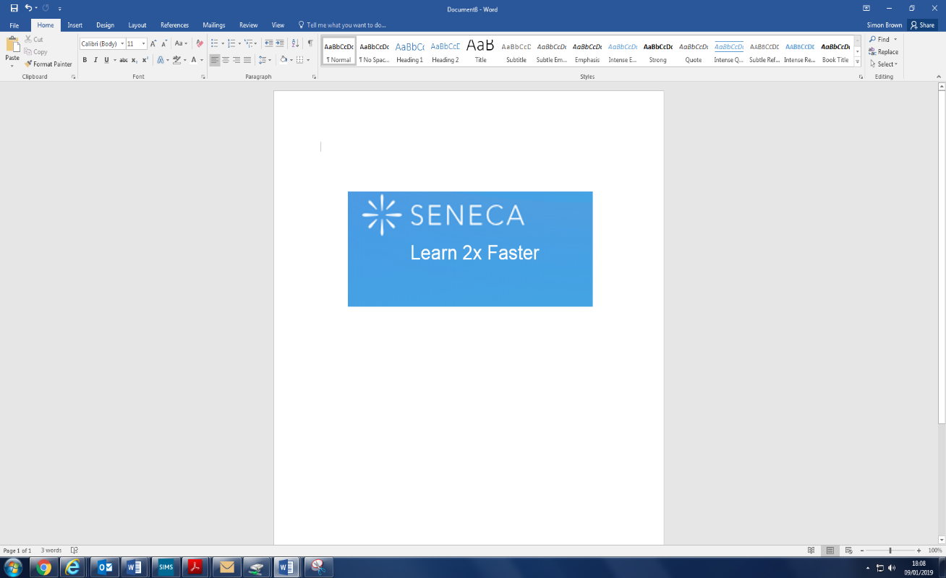








Learning Apps
Online Learning Apps
Many departments in the school have invested in online learning apps to take advantage of the excellent range of resources available to our students. These are extremely useful to build student’s knowledge which can allow them to get ahead, catch up or revise. Some apps enable students to access the course textbook at home (e.g. Kerboodle) which provides a useful resource when completing homework or revising. Others enable students to test themselves on knowledge to build their retention and prepare for assessments.
All Apps can be accessed by going through the Student Hub on the school website.
18

Slide 20
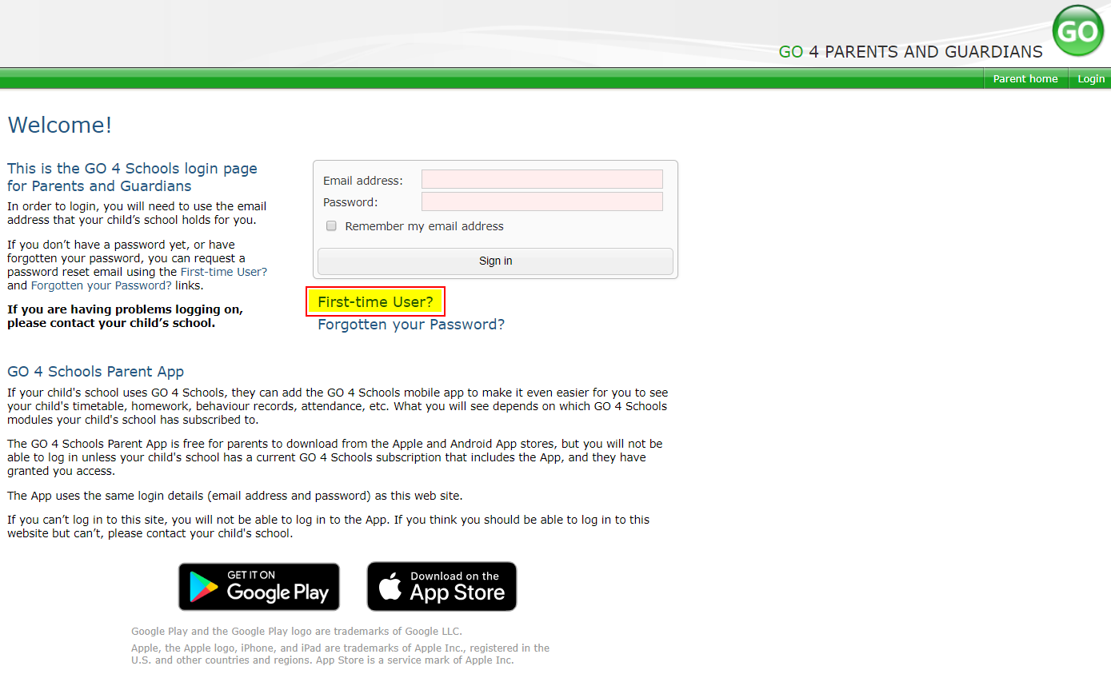
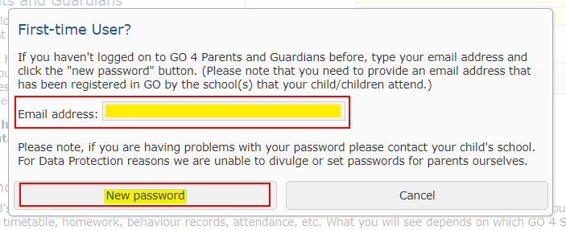
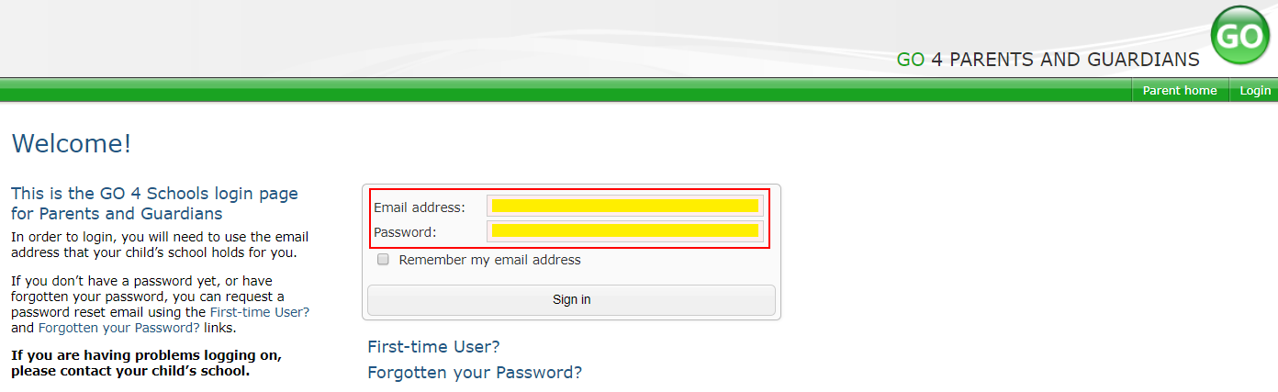
Go4Schools
Using GO 4 Schools, you will be able to view your child’s progress online and access the following information at any time:
Timetable – Your child’s daily and weekly timetable
Attendance – Shown from the start of the academic year
Progress Reports – Assessment point reports which are published 2 times a year
Behaviour information – A summary of positive and negative events, plus any managed detentions your child has been issued
Homework – Homework is set on Go4Schools and can be accessed by both parents and students via the app. Parents and students can easily see what homework has been set, when it is due and parents will also be able to track when the homework has been completed
Your child’s page is constantly updated, providing you with the latest information.
You will also have access to this information via a mobile app. Additional help documents for the Mobile App are available to parents and more information can be found at http://www.go4schools.com/MobileApp.aspx.
Accessing your Go 4 Schools Account
To access the site, please go to www.go4schools.com and click on the Parents icon at the top of the main page to arrive at the log-in screen. The email address you use to enter the site must be the one we have registered for you on our school system.
To request a password for GO 4 Schools, please click on the ‘First-time User’ link shown below.
Then enter your email address into the First-time User ‘Email address’ field and click ‘New password’. A randomised password will then be generated and sent to your email address.
You will then be able to log into the site using your email and generated password then view your child’s page using the parent and guardian login page, shown below.
19

Slide 21
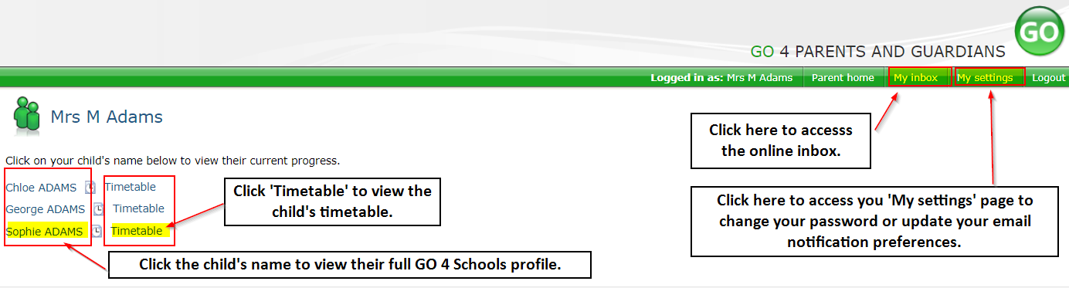
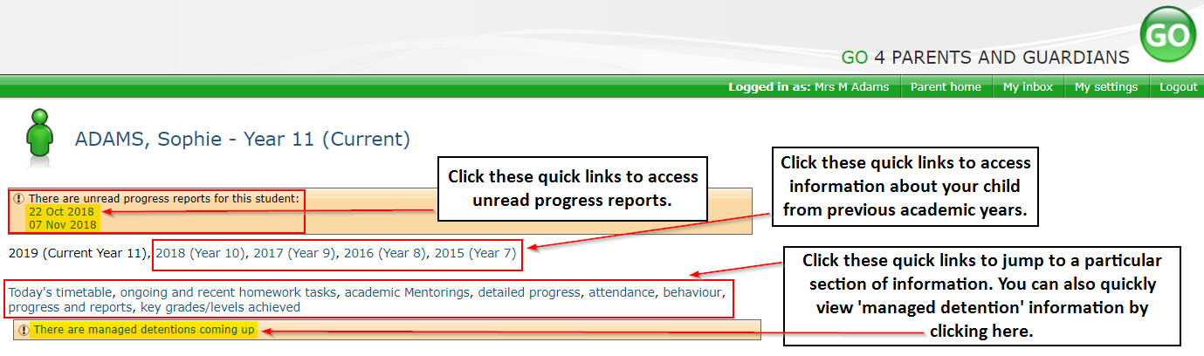
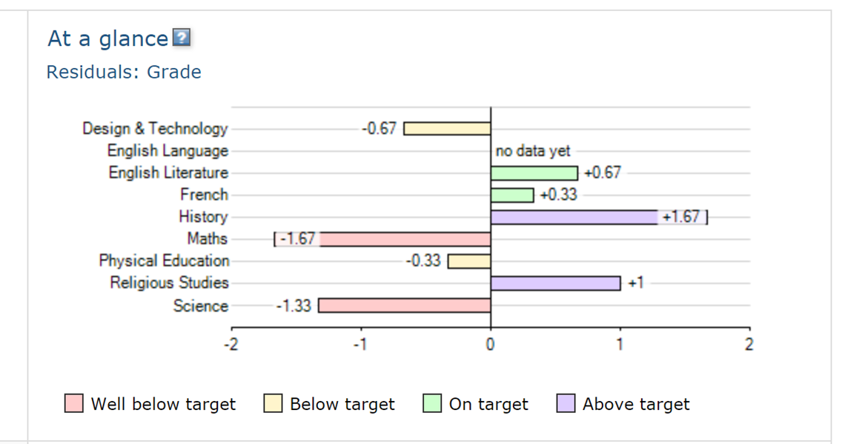
Go4Schools
Once logged in, what will you see?
At a glance
This is a quick overview of your child’s current progress against their target grades for each subject. A value of zero indicates that your child is on target, a negative value indicates below target and a positive value indicates above target
Parent home view
When you log in you will see names of your children that attend the school.
Clicking a child’s name will display the information held in GO 4 Schools about them. The top of the page give you these quick links.
20

Slide 22
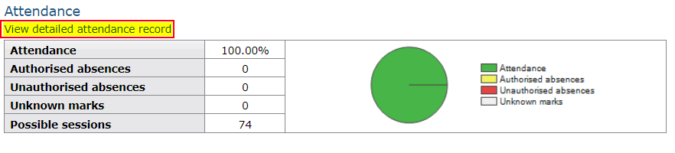
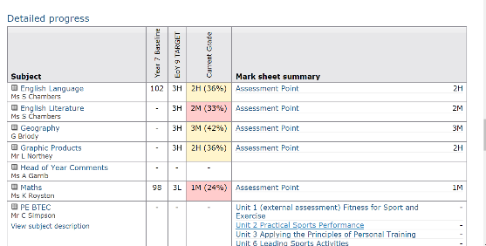
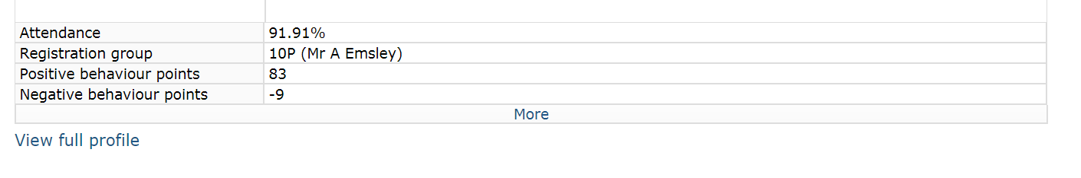
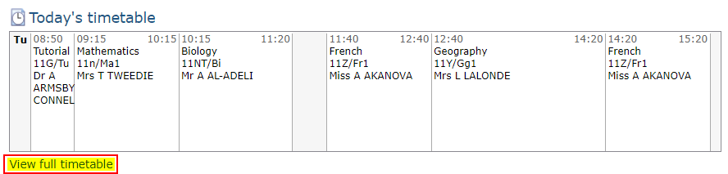
Go4Schools
Attendance Data
This information is always shown up to the previous day. Full attendance information, including weekly attendance figures, can be viewed by clicking the ‘view detailed attendance link’ shown in the yellow box.
Detailed Progress
This table shows the current levels in each subject. Also included is the target grade and colour coding to inform of progress.
Behaviour Data
This will give you an overview of positive and negative behaviour pointes.
Daily Timetable
You can click the ‘View full timetable’ link to view the full week timetable for your child or click for more detailed information on your child’s daily timetable including timings and teachers.
21

Slide 23
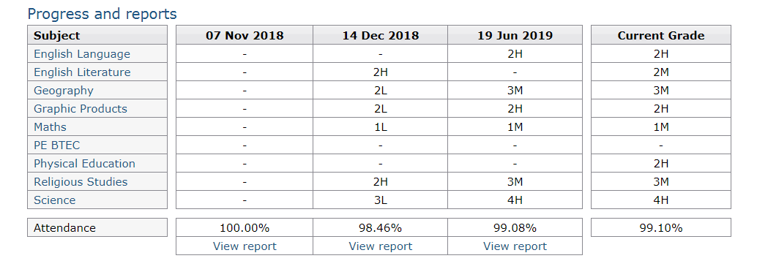
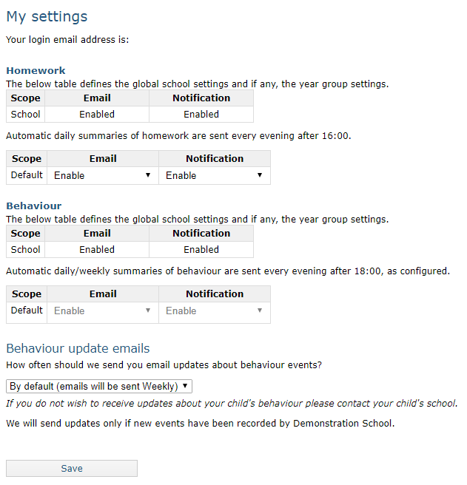
Go4Schools
Progress Reports
This shows grades for your child as they were captured by reports and compares them against current grades. At the bottom of each report column you can access a report by clicking the ‘View report’ link. You can then also download and print copies of the reports which will be available for the whole of the year.
Communication Settings
By clicking on “My settings” it will allow you to set whether you receive email notifications from GO 4 Schools, as well as show you the default setting the school has set.
22

Slide 24
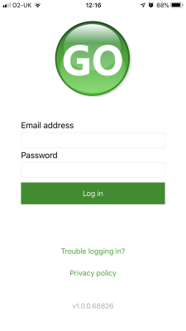
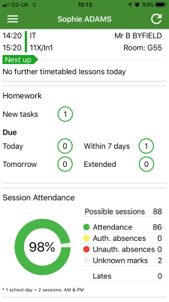
Go4Schools
How to log in to the App
Tap on the App to open.
Type in your email address and password. This is the same email address and password you use to log into the Go4Schools website.
Click on "log in". If you are a first-time user you will need to log into the website first to receive your password.
The homepage shows a student's current timetable and overview of the status of their homework. Tap on the timetable or homework to view more information.
23

Slide 25
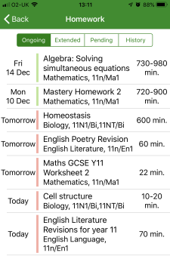
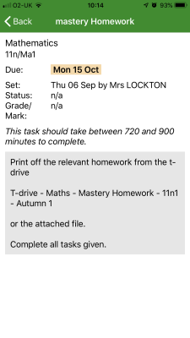
Go4Schools
How to view your child's homework
The homework card allows you to filter by ongoing, extended, pending, and homework history.
Tap on the specific homework you wish to view.
Detailed homework information is visible with attachments and weblinks. If the school tracks homework you can see when a class teacher has ticked off the completion of Homework tasks or marks if the work has been assessed.
24

Slide 26
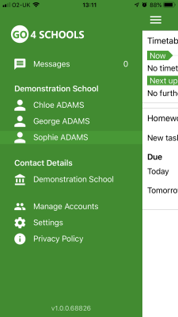
Go4Schools
How to view your messages
Tap on the menu in the top-left corner to access messages and settings.
From the menu you can view messages, or swap between schools and select individual students with GO 4 Schools accounts. Your settings can also be accessed from this menu.
25

Slide 27
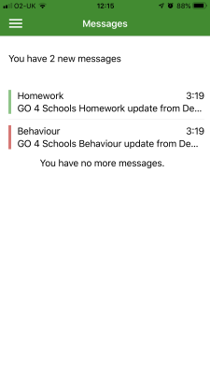
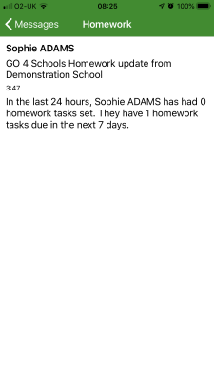
Go4Schools
How to view your messages
In the message inbox tap on the message for more detail. Your messages will be organised by date order and titled by areas such as Homework and Behaviour.
Tap back on messages and then your child's name to return to the main screen.
26

Slide 28
Go4Schools
How to view your child's attendance
The attendance information is displayed on the main App page and shows the overall percentage attendance as a chart with details for authorised and unauthorised absence including a count of late marks. Where an unknown mark is displayed this may be due to the school waiting for confirmation for the reason of the absence.
27

Slide 29
Notes
28

Slide 30
Notes
29

Slide 31
Notes
30

