Slide 1


Year 7 Curriculum Booklet
St Aloysius’ College
2021/2022

Slide 2
Contents Page
Introduction | 2
Art | 4
Computer Science | 5
Design and Technology | 6
English | 7
Geography | 8
History | 9
Mathematics | 10
Modern Foreign Languages (French) | 11
Modern Foreign Languages (Spanish) | 12
Music | 13
PE | 14
Religious Education | 15
Science | 16
Assessment & Revision | 17
Leaning Apps | 18
Go4Schools | 19
1

Slide 3
Introduction
Welcome to our Curriculum Evening. Thank you for attending this important evening.
Tonight, is all about your child and how the St Aloysius’ College community can make further impact on your sons’ personal, social and educational journey to their GCSE exams and beyond. This evening will accomplish three important aims for you and your son:
• To further develop and build on a positive and supportive relationship between parents, students and staff.
• To support you, the parent with information that will enable you to ensure that your son achieves the academic outcomes that he is capable off.
• To continue to nurture aspiration in your son so that he can make effective decisions when it comes to his education
We are here for you and your son’s education and to use this partnership to work closely together to ensure all avenues of success are taken full advantage of between now and the time your son leaves education at St Aloysius’ College.
This booklet contains information on subject curricula and more information that will be communicated this evening.
Should you require any additional assistance or support at any time, please do not hesitate to contact your son’s Head of Year.
S Kisten
Assistant Headteacher – Curriculum & Outcomes
2

Slide 4
Introduction
Dear Parent/Carer,
A smooth transition from Year 6 to Year 7 is vitally important to ensure your child settles at St. Aloysius’ College and continues to make rapid progress.
This booklet and evening is designed to raise your awareness of work and events in relation to Year 7. It is important that you are informed so that you are in a position to support your child as they negotiate their time at school and adjust to this transition period.
The evening and booklet will provide an opportunity for us to inform you of key Year 7 information including:
  Curriculum Structure
  Measuring Academic Progress, including Reports
  School & Home Support Strategies
  Target Setting
  Landmark Assessments
  Homework
  Extra-Curricular Activities
If there are any topics on which you feel you need more information, please do not hesitate to contact us.
We do hope you enjoy the evening and find this booklet useful.
Thank you for your continued support.
Yours sincerely,
Dr Ali Khan
Head of Year 7
3

Slide 5
Art
Year 7
Head of Department: Mr L. Northey
 | Autumn 1 | Autumn 2
Focus/Context for Learning | Week: 1 - Primary school art review 2 – Create a Line and Linear Table 3 – Skills Project: Van Gogh 4 – Skills Project: Van Gogh 5 – Skills Project: Van Gogh 6 – Skills Project: Van Gogh 7 - AfL: Peer and self assessment | Week 1 - Introductional to tone and shading 2 - Research on Artists – Van Gogh/Matisse. 3 - Observational drawing – Shoes. 4 - Tonal studies (drawing and painting) 5 - Tonal studies (drawing and painting) 6 - Test / AfL: Peer and self assessment
 | Spring 1 | Spring 2
Focus/Context for Learning | Week: 1 - Colour Therapy 2 - Research on Artists 3 - Colour studies: colour wheel 4 – Colour studies: colour wheel 5 - Test / AfL: Peer and self assessment 6 - Enrichment | Week: 1 - Work on Artist’s style 2 - Ideas for final piece 3 - Development and experimentation 4 - Final Piece – eg. Shoes 5 - Test / AfL: Peer and self assessment 6 - Enrichment
 | Summer 1 | Summer 2
Focus/Context for Learning | Week: 1 – Research into Cubism 2 - Development and experimentation 3 – Working in the style of the Artist 4 – Working in the style of the Artist 5 – Working in the style of the Artist 6 - Test / AfL: Peer and self assessment | Week: 1 - Work in the style of the Artist 2 - Final Piece – Cubisim 3 - Summer Art Exam week 4 - Summer Exam 5 - Enrichment 6 - Enrichment
4

Slide 6
Computer Science
Year 7
Lead Teacher: Mr N. Kakou
Computing and computer technology are part of just about everything that touches our lives from the cars we drive, to the movies we watch, to the ways businesses and governments deal with us. Understanding different dimensions of computing is part of the necessary skill set for an educated person in the 21st century. Whether one wants to be a scientist, develop the latest killer application, or just know what it really means when someone says 'the computer made a mistake', studying computing will provide you with valuable knowledge. Computing requires and develops capabilities in solving deep, multidimensional problems requiring imagination and sensitivity to a variety of concerns.
 | Autumn 1 | Autumn 2
Focus/Context for Learning | Using-computers-safely effectively-and responsibly L1 File management L2 Social networking L3 Keeping your data safe | A. Understanding computers L1 Elements of a Computer L2 The CPU L3 Understanding Binary
 | Spring 1 | Spring 2
Focus/Context for Learning | B. Understanding computers L4 Binary Addition L5 Storage Devices | Networks L1 The Internet L2 Connectivity L3 Topologies L4 Client-server networks L5 Encryption
 | Summer 1 | Summer 2
Focus/Context for Learning | Introduction to Python L1 Introducing Python L2 Numbers and Arithmetic L3 Input | B. Introduction to Python L4 Selection L5 Programming Projec
5

Slide 7
Design & Technology
Year 7
Head of Department: Mr L Northey
In Years 7, pupils will experience working in a range of material areas and undertaking various design and make projects and focus practical tasks that will build on their learning from KS2. For many students, this will be the first time they have experienced being in practical workshops and food preparation areas.
Pupils are taught the design process and study aspects of it which culminate in producing products. Throughout the course, students will also develop DT math skills to enable them to make use of measuring and accurately use standard units of length and weight.
 | Autumn 1 | Autumn 2
Focus/ Context for Learning | Drawing skill/Health & Safety Students will learn about the different graphical techniques used by designers. Graphical/Drawing Skills Understanding contexts, users and purposes. Drawing Skills: Introduction to drawing techniques. Introduction to CAD/CAM. Presentation techniques. H&S/Risk Assessment Health & Safety poster. Key words vocabulary 3D sketching to model ideas. | DESIGNING & MODELLING: Understanding contexts, users and purposes Structures Project: Students will learn about the application of the principles of structures for design and stability. Research and analysis Design brief & specifications Generating, developing & modelling ideas Technical Knowledge – Applying knowledge of materials, equipment, science and maths to help design and make products that work. Testing & Evaluation https://www.mggs.org/wp-content/uploads/Year-7-Curriculum-Booklet-2019-20-Final.pdf
 | Spring 1 | Spring 2
Focus/ Context for Learning | Introduction to electric circuits and soldering: Students will learn how to build a simple electronic circuit using solder joints. POJECT: Electronic Hand Game System and control Electronic components Evaluating/modifying/testing Electronic circuits Flow chart for making Soldering technique | Practical Focus Task: Students will learn about and design different types of card mechanisms that can create movement. Pop-up card mechanisms: Properties of paper and card Types of card mechanisms Styles of Writing/Typography Design & make different types of pop-up mechanisms.
 | Summer 1 | Summer 2
Focus/ Context for Learning | Project: Cooking and Nutrition Students will learn about the principles of nutrition and health. They will also understand the sources and characteristics of different ingredients. Basic cooking recipe: Fruit salad Apple crumble Pizza bread Bread roll/vegetable soup | Skills, knowledge & understanding Sensory Analysis Staple Foods Knife skills/safe use of kitchen equipment Analysing & Evaluating food products Cultural food Healthy Eating (The Eatwell Plate) Hygienic Food Preparation Food presentation
6

Slide 8
English
Year 7
Head of Department: Ms E. Doorly
 | Autumn 1 | Autumn 2
Focus/ Context for Learning | Non-fiction Reading & Writing READING Exposure to a range of non-fiction texts applying inference, analysis & evaluation skills LANGUAGE: AO1, 2 & 4 WRITING Non-Fiction: Arctic Adventure inspired non-fiction writing tasks. LANGUAGE AO5 & 6 SPEAKING & LISTENING Presentations LANGUAGE AO7, AO8 & AO9. | Non-fiction Reading & Writing READING Exposure to a range of non-fiction texts applying inference, analysis & evaluation skills LANGUAGE: AO1, 2 & 4 WRITING Non-Fiction: Arctic Adventure inspired non-fiction writing tasks. LANGUAGE AO5 & 6 SPEAKING & LISTENING Presentations LANGUAGE AO7, AO8 & AO9.
 | Spring 1 | Spring 2
Focus/ Context for Learning | Shakespeare READING Teach tragedy, comedy and history genre through plot/character/theme in extracts from King Lear, A Midsummer Night’s Dream and Julius Caesar. Compare similarities & differences between the genres. Preparation for Globe trip & model homework project. LITERATURE AO1, 2 , 3 WRITING Creative Writing - Narrative: writing own tragedy / Using punctuation & grammar competently (for below expected level) & for effect (for on/above expected level). LANGUAGE AO5 & 6 | The Novel READING The Novel - Trash Inference, analysis & evaluation skills LITERATURE AO1, 2 , 3 WRITING (taught through the novel) Creative Writing - Revise skills for writing a narrative using novel as stimulus. Using punctuation & grammar competently & for effect LANGUAGE AO5 & 6 SPEAKING & LISTENING Presentations LANGUAGE AO7, AO8 & AO9.
 | Summer 1 | Summer 2
Focus/ Context for Learning | The Novel READING The Novel - Trash Inference, analysis & evaluation skills LITERATURE AO1, 2 , 3 WRITING (taught through the novel) Creative Writing - Revise skills for writing a narrative using novel as stimulus. Using punctuation & grammar competently & for effect LANGUAGE AO5 & 6 SPEAKING & LISTENING Presentations LANGUAGE AO7, AO8 & AO9. | Poetry READING Poetry: Spoken word /performance poetry. Inference, & analysis skills Comparison of poems LITERATURE AO1, 2 , 3 WRITING Creative writing skills . Writing own poetry based on poems studied. LANGUAGE AO5 & AO6 SPEAKING & LISTENING Rehearsing & performing own poetry. Understand language use and meaning, using role, intonation, tone, volume, mood, silence, stillness and action to add impact. LANGUAGE AO7, AO8 & AO9
7

Slide 9
xd
Geography
Year 7
Head of Department: Ms G. Briody
“Geography is a living, breathing subject, constantly adapting itself to change. It is dynamic and relevant. For me, geography is a great adventure with a purpose.”
- Michael Palin
 | Autumn 1 | Autumn 2
Focus/Context for Learning | Transition Unit Baseline assessment Physical and human geography of the British Isles Location knowledge - continents, oceans and seas Map skills - grid referencing, map symbols, compass direction, scale, latitude and longitude My local place study | Africa Physical geography of Africa - climate, biomes and key features Population and development within the continent The Horn of Africa as a region study - physical landscapes, industry, development
 | Spring 1 | Spring 2
Focus/Context for Learning | Rivers Physical landscape of the UK Hydrological Cycle River processes Landforms of erosion and deposition Flood management - hard and soft engineering strategies t | Asia Physical geography of Asia including climate, biomes and key features Contrasting levels of development in China, India and Russia as part of the emerging BRIC economies China’s One Child Policy The growth of manufacturing and trading links between Asia and the wider world.
 | Summer 1 | Summer 2
Focus/Context for Learning | Extreme Environments UK during the last Ice Age Glaciers Glaciation processes Landforms of erosion and deposition UK glaciated landscape Extreme tourism - Antarctica | Geology and Soil UK geology Rocks types and formation The rock cycle Weathering Soils Nutrient cycle Links between the water and carbon cycles
8

Slide 10
History
Year 7
Head of Department: Mrs G. Rimmer
In your study in History during Year 7 you will study the Medieval world through to the Tudor Age. This will provide you with an understanding of how the past has changed over a period of time, what influences changed how people lived and how Great Britain began to expand it influence in different parts of the world.
 | Autumn 1 | Autumn 2
Focus/ Context for Learning | Unit 1: England before 1066, the movement of different groups of people and the influences they had on the developing country. Unit 2: The Norman Conquest and the Battle of Hastings 1066. | Unit 3: The conquest of England, how did King William enforce his rule on England? The Domesday Book The Feudal system Castle building
 | Spring 1 | Spring 2
Focus/ Context for Learning | Unit 4: To investigate the importance of religion in Medieval times. Thomas Becket and Henry 11 The medieval Church including monasteries. Unit 5: Comparison of England and other Medieval societies e.g. The Mali Empire, The Ottoman Empire and Great Zimbabwe | Unit 6: The Black Death and the Peasants Revolt. Overview: Change and continuity over the Medieval period.
 | Summer 1 | Summer 2
Focus/ Context for Learning | Unit 7: Introduction to the Tudors: How powerful was Henry V111? Henry V111 and the Church Elizabeth 1: How was she portrayed? The significance of portraits as historical sources. Attacked! The Spanish Armada | Unit 7: The wider Tudor world. The importance of trade What was life like for Black people in the Tudor period? The Renaissance
9

Slide 11
Mathematics
Year 7
Head of Department: Ms A. Toprak
Mathematics is a creative and highly interconnected discipline that has been developed over centuries, providing the solution to some of history’s most intriguing problems. It is essential to everyday life, critical to science, technology and engineering, and necessary for financial literacy and most forms of employment. A high-quality mathematics education therefore provides a foundation for understanding the world, the ability to reason mathematically, an appreciation of the beauty and power of mathematics, and a sense of enjoyment and curiosity about the subject.
 | Autumn 1 | Autumn 2
Focus/Context for Learning | Graphs and sequences Mensuration Calculations Proportion and percentages Equations and formulae Assessment: Class test, progress test, MemRi, Hegarty maths, Written and past exam question homework. | Number Angles Data Transformations Calculations Assessment: Progress test, MemRi, Hegarty maths, Written and past exam question homework. AP1
 | Spring 1 | Spring 2
Focus/Context for Learning | Equations and formulae Data Number Angles Mensuration Assessment: Class test, progress test, MemRi, Hegarty maths, Written and past exam question homework | Proportion and percentages Transformations Graphs and sequences Assessment: Progress test, MemRi, Hegarty maths, Written and past exam question homework and Progress check.
 | Summer 1 | Summer 2
Focus/Context for Learning | Angles Probability Equations and formulae Number Graphs and sequences Assessment: Class test, progress test, MemRi, Hegarty maths, Written and past exam question homework | Calculations Constructions Assessment: Progress test, MemRi, Hegarty maths, Written and past exam question homework and Progress check. AP2
10

Slide 12
MFL: French
Year 7
Head of Department: Ms C. Mauris-Blanc
 | Autumn 1 | Autumn 2
Focus/ Context for Learning | Tout sur moi. Learn numbers and the months of the year. Say where you live, what languages you speak and your nationality. Describe your appearance and that of another person Name and describe your favourite object. Name some French-speaking parts of the world. | Mon Monde Describe personality. Describe your family. Give opinions of school subjects Talk about your friends and how long you have known them. Talk in detail about your family and home. Analyse differences in your personality (past/present).
 | Spring 1 | Spring 2
Focus/ Context for Learning | Autour de Moi Talk about the school and where you live. Talk about different places to live. Talk about leisure activities and personal possessions. Talk about animals and colours. | À table! Talk about food. Give opinions of food and drink. Talk about your favourite restaurant and order food. Understand quantities and recipes. Talk about food and art. Grammar, language strategies and pronunciation.
 | Summer 1 | Summer 2
Focus/ Context for Learning | Mon Quartier. Understand places in town. Describe a town. Say what activities you can do at different places. Ask for and give directions. Arrange to go out. Discuss meeting places. Identify and describe the location of places on a map. | Ça c’est mon truc! Present tense of regular and irregular verbs. Possessive adjectives (Son-sa-ses). Reflexive verbs( se lever et se coucher). Talk about clothes and say what style you like. Talk about the weather and what you wear on different occasions. Say how often you do an activity. Talk about weekend activities. Talk about music and national events.
11

Slide 13
MFL: Spanish
Year 7
Head of Department: Ms C. Mauris-Blanc
 | Autumn 1 | Autumn 2
Focus/ Context for Learning | Módulo 1: ¡Bienvenidos! Ask / say your name & greetings. Say what is in your school bag. Ask and give your age. Ask and give your birthday (dates). Understand classroom instructions. Spell your and other people’s names (alphabet). Name the parts of a computer. | Módulo 2: Tú y yo Ask/say where you are from (nationalities) and what languages you speak. Ask/say where you live. Talk about your family and pets. Describe your eyes and hair. Talk about your size.
 | Spring 1 | Spring 2
Focus/ Context for Learning | Módulo 3: ¡Vamos al instituto! Talk about school subjects. Give opinions about school subjects. Ask and tell the time and talk about your school timetable. Talk about school mealtimes. Describe your school. Say how to get to school. | Módulo 4: En casa Talk about your home and say where it is. Describe your house and the rooms in your house. Describe your bedroom. Talk about your morning routine. Talk about what you do after school.
 | Summer 1 | Summer 2
Focus/ Context for Learning | Módulo 5: Mi pueblo Say where you are going in the area. Give and understand directions. Describe locations of places in a town and give more detailed directions. Talk about distance. Talk about what your town is like. Talk about the weather. | Módulo 6: El tiempo libre Talk about sports. Talk about what you like doing in your free time. Talk about what you do during the week and at weekends. Arrange to go out. Say what you are going to do at the weekends. Say how you help at home and how you are going to help at the weekend.
12

Slide 14
Music
Year 7
Head of Department: Mr O. Bunting
Creating music as both a composer & performer is at the heart of all learning intentions. We encourage our learners to engage with this philosophy by participating in the wider context of the music curriculum, through involvement in our ‘Music Extra Curricular Program’ of which we pride ourselves in both the diversity and inclusive approaches for all children.
Year 11 | Autumn 1 | Autumn 2
Focus/Context for Learning | Rhythm, Notation & Melody Using basic notation Composing rhythms Performing percussion work Composing keyboard melody Aural test: Rhythm dictation Written test: Notation values | Notation, Melody & Structure Basic pitch notation Simple structures Ternary form composition Ternary form performance Aural test: Structures Written test: Pitch Notation
 | Spring 1 | Spring 2
Focus/Context for Learning | Ukulele Skills: Pop Songs Basic techniques Simple chord shapes Simple rhythm patterns Basic pop song ensemble Aural test: techniques & Chord shapes Written test: Simple chord shapes | Instruments & Elements Instruments & families Exploring dynamics Exploring tempo Aural Test: Instruments recognition, dynamics & tempo Written Test: Describing instruments, dynamic & tempo changes
 | Summer 1 | Summer 2
Focus/Context for Learning | Music of Africa Part 1 African traditional music analysis Traditional African song Call & response singing African traditional instruments Aural test: Instrument recognition Written test: describe traditional instruments | Music of Africa Part 2 Pentatonic scale Composing ostinato ideas Perform improvisations Polyrhythmic percussion skills Written test: respond to questions about African Traditions
13

Slide 15
PE
Year 7
Head of Department: Mr S. Henderson
Core PE is exclusively practical. Throughout key stage 3 all students take part in one double lesson of physical education per week. This adheres to the national requirement of all 11-14 year olds accessing a minimum of two hours of physical education per week. There are also extensive opportunities for students to participate in extra-curricular sport before school, at lunchtime and after school.
We deliver a winter programme that is traditionally games based that helps develop skills such as outwitting opponents, defining roles within team games and moreover a duty of care within a team setting where cohesion and communication are paramount to success. In the winter term there are also opportunities to develop physical attributes such as cardiovascular fitness, muscular endurance, strength and speed along with other important components of fitness.
In the summer term pupils are taught a wide range of athletics disciplines with an equal opportunity to develop in both track and field events. Striking and fielding also plays an integral part in the summer term and allows both team and individual skills to be developed accordingly.
Pupils will not gain a qualification during key stage three. However the skills and knowledge they acquire act as a pathway to success if they decide to access a qualification in PE at key stage 4 or 5.
Year 11 | Autumn 1 | Autumn 2
Focus/Context for Learning | Basketball: The fundamental skills of passing and dribbling form the main focus in year 7. Shooting in both passive and pressured situations are built into lessons to form the basis of a full game. All the basic laws of the game are taught. | Rugby: Students are taught the fundamental skills within the game such as running with the ball, evading opponents, passing, tackling and rucking. The length of the unit allows boys to make rapid progress regardless of previous experience in the sport.
 | Spring 1 | Spring 2
Focus/Context for Learning | Health Related Fitness: Students are able to improve components of fitness within this unit. Emphasis is on extended periods of activity whilst informing pupils of the benefits of leading a healthy lifestyle. | Handball: This unit focuses on individual skills such as shooting, dribbling, passing and spatial awareness. Students are taught to develop these skills under ever increasing demands and get the opportunity to play in small sided games.
 | Summer 1 | Summer 2
Focus/Context for Learning | Tennis: Students are taught the basic fundamental elements of tennis. While developing their skills, they will also have the chance to officiate games. Athletics: Each discipline is taught as an introductory lesson with pupils spending two lessons on each event. The fundamental skills and tactics involved will be taught along with the knowledge of how to measure and record. | Softball: This unit allows students to experience striking and fielding in an alternative sport. Introduction to core skills along with strategy and rules forms the basis of this unit. Cricket: An opportunity to develop batting, bowling and fielding feature in year 7. Time is spent on core skills that help individuals develop as an individual and as a team player. In year 7 we introduce the core skills such as throwing, catching, batting and fielding. They gain an understanding of basic rules of the game.
14

Slide 16
Religious Education
Year 7
Head of Department: Ms L. Carter
 | Autumn 1 | Autumn 2
Focus/Context for Learning | Introduction to St Aloysius- this unit gives students an introduction into the school values, an insight into the lives of the school saints and a chance to reflect on what their example teaches Christians today. Bible- This unit gives students an understanding of the formation of the Bible and the types of writings that can be found within the Bible. It examines the importance of both the Old and New Testament for Christians today. Creation- This unit reflects on what the story of Genesis teaches us about God, man’s place within the world and how evil entered the world through the fall of man. It gives students an opportunity to reflect on whether evil is a problem for a belief in God. | God’s People in the Old Testament – This unit looks at how God formed covenants with the people in the Old Testament, it follows the characters: Noah, Abraham, Joseph and Moses on their faith journey. It looks at the role of the ten commandments in the lives of the people in Old Testament and examines their relevance today.
 | Spring 1 | Spring 2
Focus/Context for Learning | God’s People in the Old Testament – This unit continues to look at the history of the Jews living in the Promised Land under the authority of the monarchs King David and King Solomon. It looks at the strengths and the failings of King David and King Solomon and the events that led to the exile of Jews by the Babylonians. Incarnation – This unit looks at the development of the promise of the Messiah in Old Testament and how this promise was fulfilled through the birth of Jesus Christ. It looks at the role of Mary in bringing about the incarnation and what Jesus’ birth means for lowliest in society. | Incarnation -This unit continues to examine who Jesus is through the writings of the gospels, looking at the stories of Jesus’ birth and miracles. It also examines the need for God to be incarnated and what it means to call Jesus fully man and fully God. Jesus’ teachings- This unit looks at Jesus’ teachings on the Sermon of the Mount, the Beatitudes and how Jesus used parables to explain what the Kingdom of God is.
 | Summer 1 | Summer 2
Focus/Context for Learning | The Paschal Mystery- This unit looks at the events of Holy Week that led to Jesus’ death and resurrection. This unit examines how Jesus’ death and resurrection result in human salvation and what that means for Catholics understanding of the afterlife. | Islamic beliefs- This unit looks at the core beliefs in Islam, such as their belief about Allah, prophets, the Qur’an, angels, pre-destination and life after death
15

Slide 17
Science
Year 7
Head of Department: Ms H. Clarke
For Science to be a department of excellence, collaboration, motivation and engagement.
Every child is entitled to a good education and we are committed in ensuring all pupils make greater than expected progress across all Key Stages, by developing scientific enquiry, numeracy and literacy through practical activity and outstanding teaching.
Learning is our priority.
Year 11 | Autumn 1 | Autumn 2
Focus/Context for Learning | Working scientifically Investigation Skills for Science 1B. Organisms Movement and Cells | 2P. Energy Energy cost and Transfer 3C. Matter Particle Model and Separating Mixtures
 | Spring 1 | Spring 2
Focus/Context for Learning | 4B. Genes Variation and Human Reproduction 5P. Waves Sounds and Light | 6C. Reactions Acid and Alkalis, Metals and non Metals 7B. Ecosystem Interdependence and Plant Reproduction
 | Summer 1 | Summer 2
Focus/Context for Learning | 8P. Forces Speed and Gravity | 9P. Electromagnets Voltage Resistance and Current
16

Slide 18
Assessments & Revision
We strive for each and every pupil at St Aloysius to achieve their greatest potential. For that reason there are multiple assessments and revision opportunities in place to ensure that pupils know their projected grades at intervals throughout the year and are supported in improving upon them.
Year 7 Assessment Schedule
The Year 7 curriculum is focused on embedding the skills and knowledge needed for a smooth transition into secondary education. Students will follow the school assessment schedule. In Year 7 their assessment schedule is as follows:-
AP1 – 15th November 2021
Progress Check – 7th March 2022
AP2 – 6th June 2022
Pupils that underachieved will have to attend a meeting with their parents and a senior member of staff to discuss lack of progress. The pupils may be asked to resit another assessment.
Reports will be available after each assessment point on Go4Schools. Please use the report to discuss your son’s progress and the next steps with them.
17

Slide 19









Learning Apps
Online Learning Apps
Many departments in the school have invested in online learning apps to take advantage of the excellent range of resources available to our students. These are extremely useful to build student’s knowledge which can allow them to get ahead, catch up or revise. Some apps enable students to access the course textbook at home (e.g. Kerboodle) which provides a useful resource when completing homework or revising. Others enable students to test themselves on knowledge to build their retention and prepare for assessments.
All Apps can be accessed by going through the Student Hub on the school website.
18

Slide 20
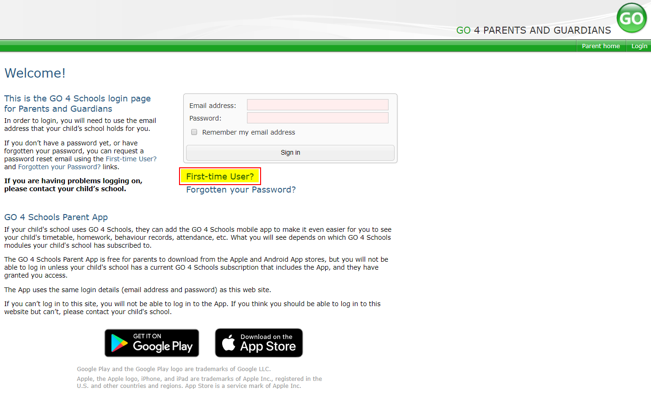
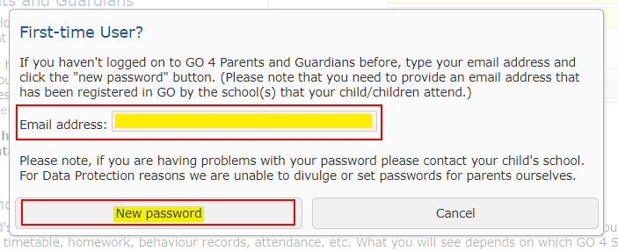
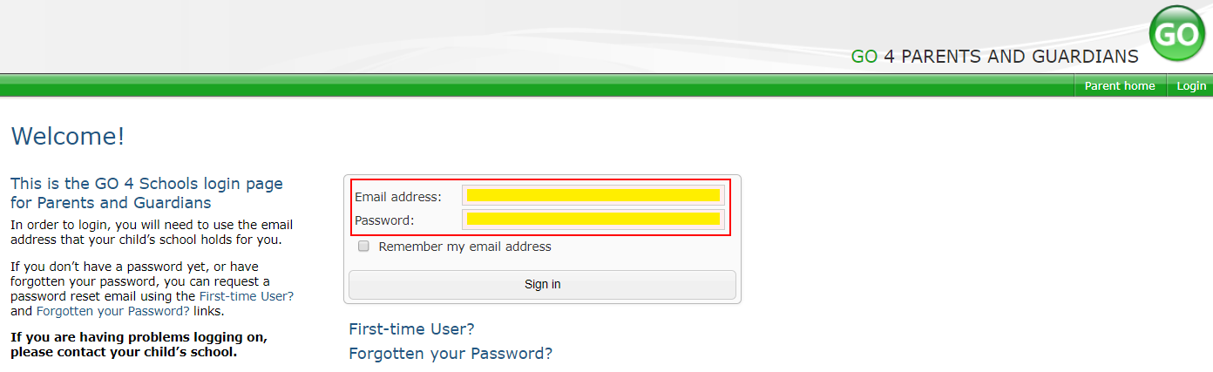
Go4Schools
Using GO 4 Schools, you will be able to view your child’s progress online and access the following information at any time:
Timetable – Your child’s daily and weekly timetable
Attendance – Shown from the start of the academic year
Progress Reports – Assessment point reports which are published 2 times a year
Behaviour information – A summary of positive and negative events, plus any managed detentions your child has been issued
Homework – Homework is set on Go4Schools and can be accessed by both parents and students via the app. Parents and students can easily see what homework has been set, when it is due and parents will also be able to track when the homework has been completed
Your child’s page is constantly updated, providing you with the latest information.
You will also have access to this information via a mobile app. Additional help documents for the Mobile App are available to parents and more information can be found at http://www.go4schools.com/MobileApp.aspx.
Accessing your Go 4 Schools Account
To access the site, please go to www.go4schools.com and click on the Parents icon at the top of the main page to arrive at the log-in screen. The email address you use to enter the site must be the one we have registered for you on our school system.
To request a password for GO 4 Schools, please click on the ‘First-time User’ link shown below.
Then enter your email address into the First-time User ‘Email address’ field and click ‘New password’. A randomised password will then be generated and sent to your email address.
You will then be able to log into the site using your email and generated password then view your child’s page using the parent and guardian login page, shown below.
19

Slide 21
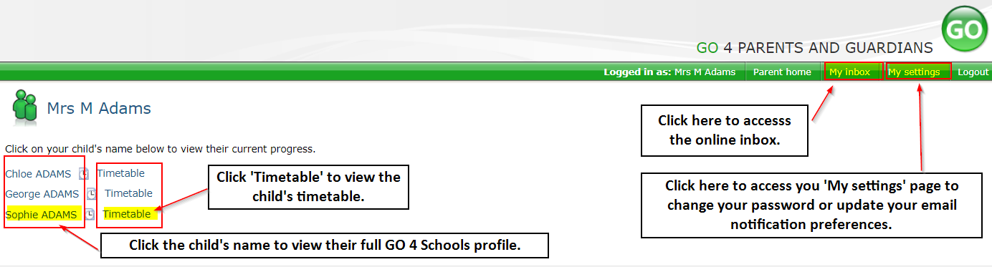
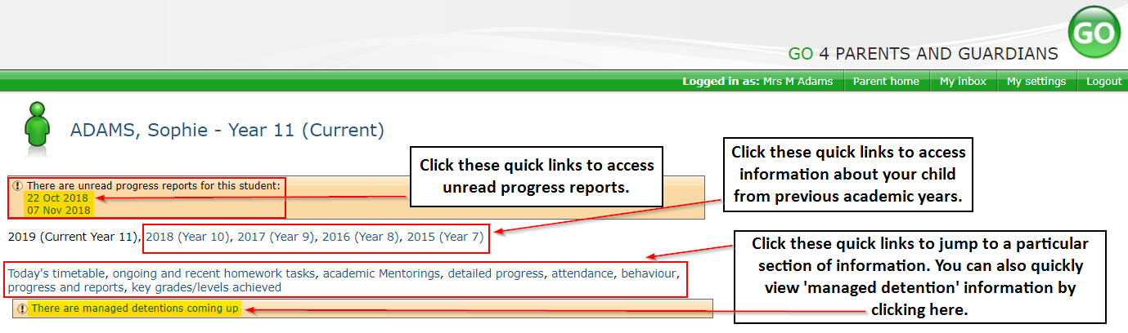
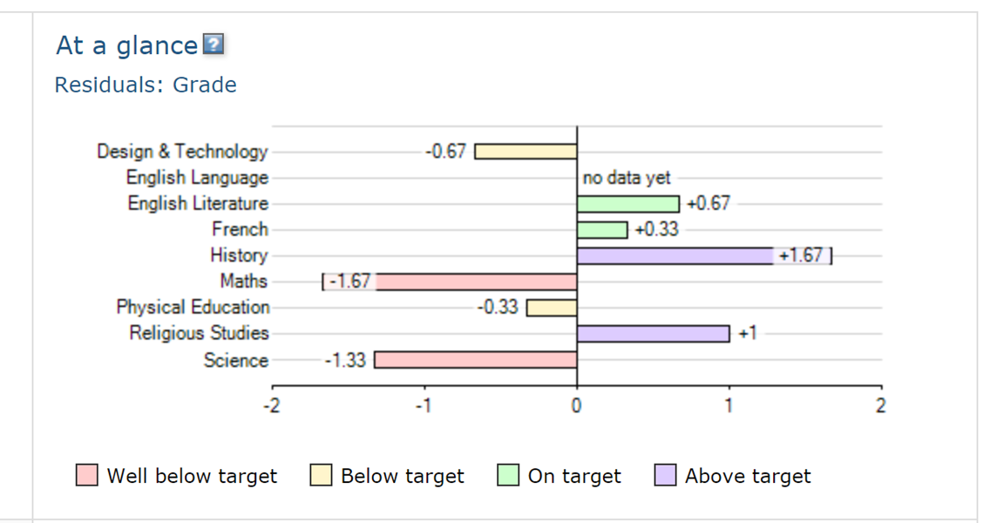
Go4Schools
Once logged in, what will you see?
At a glance
This is a quick overview of your child’s current progress against their target grades for each subject. A value of zero indicates that your child is on target, a negative value indicates below target and a positive value indicates above target
Parent home view
When you log in you will see names of your children that attend the school.
Clicking a child’s name will display the information held in GO 4 Schools about them. The top of the page give you these quick links.
20

Slide 22
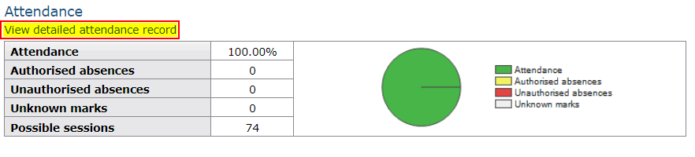
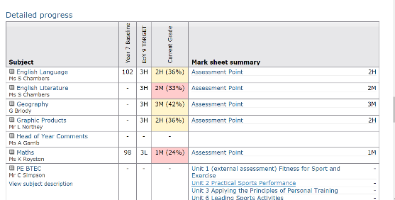
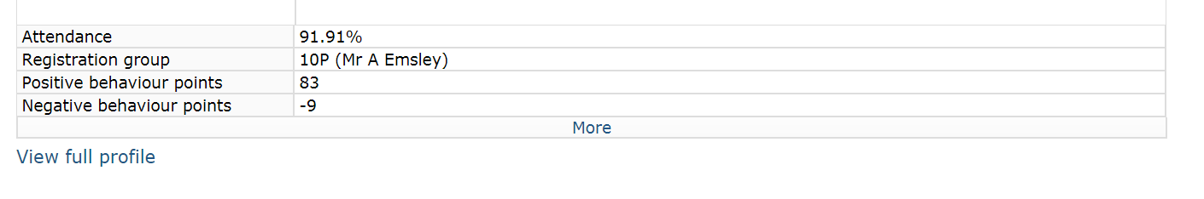
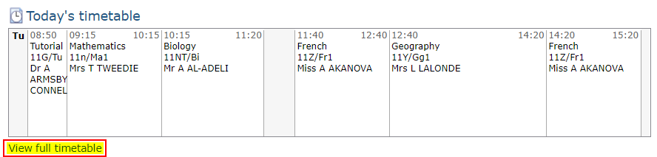
Go4Schools
Attendance Data
This information is always shown up to the previous day. Full attendance information, including weekly attendance figures, can be viewed by clicking the ‘view detailed attendance link’ shown in the yellow box.
Detailed Progress
This table shows the current levels in each subject. Also included is the target grade and colour coding to inform of progress.
Behaviour Data
This will give you an overview of positive and negative behaviour pointes.
Daily Timetable
You can click the ‘View full timetable’ link to view the full week timetable for your child or click for more detailed information on your child’s daily timetable including timings and teachers.
21

Slide 23
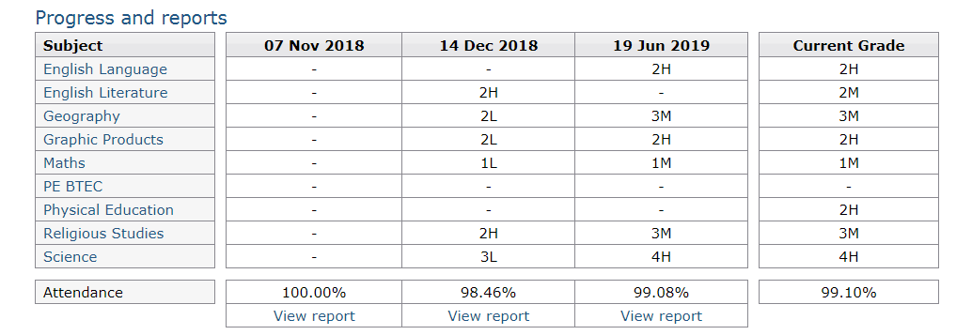
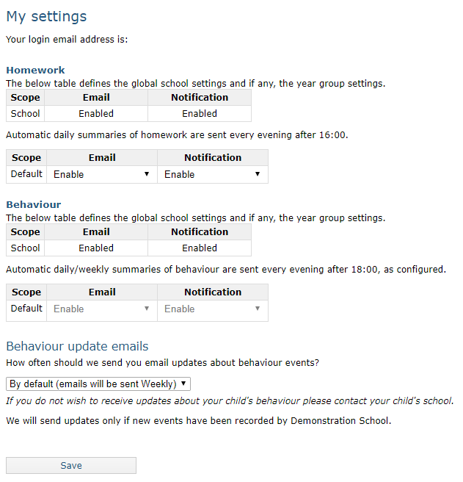
Go4Schools
Progress Reports
This shows grades for your child as they were captured by reports and compares them against current grades. At the bottom of each report column you can access a report by clicking the ‘View report’ link. You can then also download and print copies of the reports which will be available for the whole of the year.
Communication Settings
By clicking on “My settings” it will allow you to set whether you receive email notifications from GO 4 Schools, as well as show you the default setting the school has set.
22

Slide 24
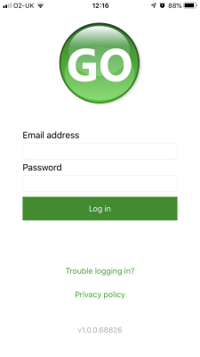
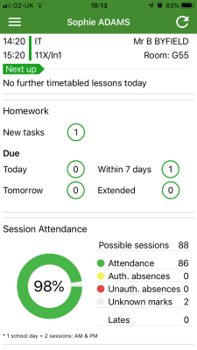
Go4Schools
How to log in to the App
Tap on the App to open.
Type in your email address and password. This is the same email address and password you use to log into the Go4Schools website.
Click on "log in". If you are a first-time user you will need to log into the website first to receive your password.
The homepage shows a student's current timetable and overview of the status of their homework. Tap on the timetable or homework to view more information.
23

Slide 25
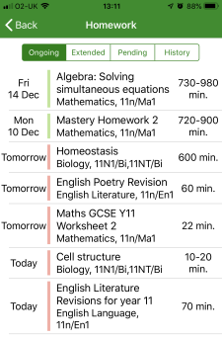
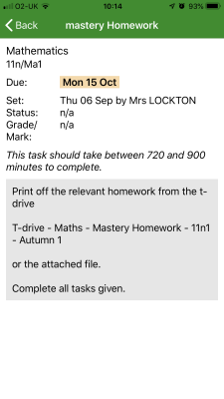
Go4Schools
How to view your child's homework
The homework card allows you to filter by ongoing, extended, pending, and homework history.
Tap on the specific homework you wish to view.
Detailed homework information is visible with attachments and weblinks. If the school tracks homework you can see when a class teacher has ticked off the completion of Homework tasks or marks if the work has been assessed.
24

Slide 26
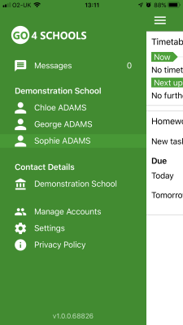
Go4Schools
How to view your messages
Tap on the menu in the top-left corner to access messages and settings.
From the menu you can view messages, or swap between schools and select individual students with GO 4 Schools accounts. Your settings can also be accessed from this menu.
25

Slide 27
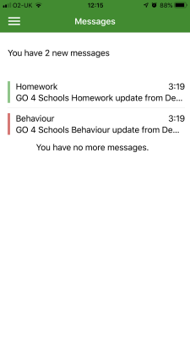
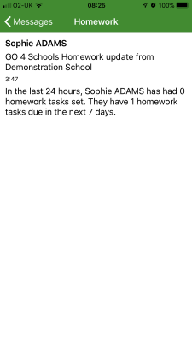
Go4Schools
How to view your messages
In the message inbox tap on the message for more detail. Your messages will be organised by date order and titled by areas such as Homework and Behaviour.
Tap back on messages and then your child's name to return to the main screen.
26

Slide 28
Go4Schools
How to view your child's attendance
The attendance information is displayed on the main App page and shows the overall percentage attendance as a chart with details for authorised and unauthorised absence including a count of late marks. Where an unknown mark is displayed this may be due to the school waiting for confirmation for the reason of the absence.
27

Slide 29
Notes
28

Slide 30
Notes
29

