Slide 1


Year 9 Curriculum Booklet
St Aloysius’ College
2021/2022

Slide 2
Contents Page
Introduction | 2
Art | 4
Business Studies | 5
Computer Science | 6
Design and Technology | 7
English | 8
Geography | 9
Graphics | 10
History | 11
Mathematics | 12
Modern Foreign Languages (French) | 13
Modern Foreign Languages (Spanish) | 14
P.E. (GCSE) | 15
P.E. : Sports (BTEC) | 16
Religious Education | 17
Science | 18
Assessment & Revision | 19
Leaning Apps | 20
Go4Schools | 21
1

Slide 3
Introduction
Welcome to our Curriculum Evening. Thank you for attending this important evening.
Tonight, is all about your child and how the St Aloysius’ College community can make further impact on your sons’ personal, social and educational journey to their GCSE exams and beyond. This evening will accomplish three important aims for you and your son:
• To further develop and build on a positive and supportive relationship between parents, students and staff.
• To support you, the parent with information that will enable you to ensure that your son achieves the academic outcomes that he is capable off.
• To continue to nurture aspiration in your son so that he can make effective decisions when it comes to his education
We are here for you and your son’s education and to use this partnership to work closely together to ensure all avenues of success are taken full advantage of between now and the time your son leaves education at St Aloysius College.
This booklet contains information on subject curricula and more information that will be communicated this evening.
Should you require any additional assistance or support at any time, please do not hesitate to contact your son’s Head of Year.
S Kisten
Assistant Headteacher – Curriculum & Outcomes
2

Slide 4

Introduction
Dear Parent/Carer,
Year 9 marks the start of a three year journey towards GCSE success. Your son will gain a deep knowledge of his subjects in preparation for his exams and assessments. Year 9 will also be a key year for you son to develop aspirations and build his reference file for the next stage of his education post 16.
This booklet and evening is designed to raise your awareness of work and events in relation to Year 9. It is important that you are informed so that you are in a position to support your child as they negotiate their time at school and adjust to this transition period.
The evening and booklet will provide an opportunity for us to inform you of key Year 9 information including:
  Curriculum Structure
  Measuring Academic Progress, including Reports
  School & Home Support Strategies
  Target Setting
  Landmark Assessments
  Homework
If there are any topics on which you feel you need more information, please do not hesitate to contact us.
We do hope you enjoy the evening and find this booklet useful.
Thank you for your continued support.
Your Sincerely
Mr Neville
Head of Year 9
3

Slide 5
Art
Year 9
Head of Department: Mr Northey
The course follows a three-year syllabus that encompasses the four criteria of the GCSE exam, in a variety of media. Pupils work on a three-module format that is designed to encourage an understanding of the development of art, linking in aspects of the modern world, through social, political and historical issues. The course begins as an in depth skill based programme which enables students to become more confident in a range of artistic techniques. Experimentation is key to the course and students develop their ideas and knowledge of artists through sketchbook and independent study. The course is designed to provide students with all the requisite skills and knowledge necessary to become A level students and to pursue an artistic career.
Year 11 | Autumn 1 | Autumn 2
Focus/Context for Learning | Week: Introduction to Mask project Research Designers Observation drawing Work in Artist’s style Final Piece Final Piece Enrichment | Week: Mask making/sculpture Development of mask design Development of mask design Development of mask design Completion of final piece Christmas Exam Enrichment
 | Spring 1 | Spring 2
Focus/Context for Learning | Week: Introduction to Portraiture Artist Research Observation drawing Same as above Work in Artist’s style Final Piece Final Piece | Week: Artist Research Development of painting skills Development of painting skills Development of painting skills Final piece Final piece Enrichment
 | Summer 1 | Summer 2
Focus/Context for Learning | Week: Introduction to Architecture Research on Architects Perspective drawing Development & experimentation Final Piece Enrichment | Week: Research on landscape & Architecture Investigate artists Development and experimentation Final Piece Test/AfL: Peer and Self-assessment Enrichment
4

Slide 6
Business Studies
Year 9
Head of Department: Mr M. Caceres
You’ll start by exploring the world of small businesses through the lens of an entrepreneur. How and why do business ideas come about? What makes a successful business? You’ll learn how to develop an idea, spot an opportunity and turn it into a successful business. You will understand how to make a business effective, manage money and see how the world around us affects businesses and all the people involved.
Year 11 | Autumn 1 | Autumn 2
Focus/Context for Learning | 1.1 Enterprise and entrepreneurship 1.1.1 The dynamic nature of business 1.1.2 Risk and reward 1.1.3 The role of business enterprise | 1.2 Spotting a business opportunity 1.2.1 Customer needs 1.2.2 Market research
 | Spring 1 | Spring 2
Focus/Context for Learning | 1.2.3 Market segmentation 1.2.4 The competitive environment 1.3 Putting a business idea into practice 1.3.1 Business aims and objectives | 1.3 Putting a business idea into practice 1.3.2 Business revenues, costs and profits 1.3.3 Cash and cash-flow 1.3.4 Sources of business finance
 | Summer 1 | Summer 2
Focus/Context for Learning | Topic 1.4 Making the business effective 1.4.1 The options for start-up and small businesses 1.4.2 Business location 1.4.3 The marketing mix | Topic 1.4 Making the business effective 1.4.4 Business plans Topic 1.5 Understanding external influences on business 1.5.1 Business stakeholders 1.5.2 Technology and business
5

Slide 7
Computer Science
Year 9
Lead Teacher: Mr N. Kakou
Computing and computer technology are part of just about everything that touches our lives from the cars we drive, to the movies we watch, to the ways businesses and governments deal with us. Understanding different dimensions of computing is part of the necessary skill set for an educated person in the 21st century. Whether one wants to be a scientist, develop the latest killer application, or just know what it really means when someone says 'the computer made a mistake', studying computing will provide you with valuable knowledge. Computing requires and develops capabilities in solving deep, multidimensional problems requiring imagination and sensitivity to a variety of concerns.
 | Autumn 1 | Autumn 2
Focus/Context for Learning | Systems architecture L1 Architecture of the CPU L2 CPU performance L3 Memory L4 Secondary Storage B. Programming techniques (Python) | Data Representation L1 Storage Units & Binary L2 Binary L3 Binary arithmetic L4 Hexadecimal B. Programming techniques (Python)
 | Spring 1 | Spring 2
Focus/Context for Learning | A. Data Representation L5 ASCII and Unicode L6 Images L7 Sound L8 Compression B. Programming techniques (Python) | Network L1 Wired and wireless networks L2 Network topologies L3 protocols and layers B. Programming techniques (Python)
 | Summer 1 | Summer 2
Focus/Context for Learning | System security Systems software C. Programming techniques (Python) | Ethical, legal, cultural and environmental concerns Programming techniques (Python) Past Papers: Paper 1
6

Slide 8
Design & Technology
Head of Department: Mr L Northey
Year 9
In year 9, students will be encouraged to work more independently, consolidating and improving on their knowledge and understanding of materials and processes explored in year 8. There will be opportunities for students to further improve on their practical skills and diversify in the range of materials, components; tools and equipment used including CAD/CAM. Teaching and learning will be challenging and robust, consisting of a variety of formal skills teaching; ‘learning through doing’ practical activities and skills building; research methods; creativity & problem solving, maths skills, retrieval practices, questioning and reflective evaluations (self, peer and group opportunities).
 | Autumn 1 | Autumn 2
Focus/Context for Learning | Project: Design and market influences Role of client, user, designer & Manufacturer Market Pull and Technology Push Materials & their working properties Design movement/Design strategies Sketching/formal 2D, 3D drawings Manufacturing Processes Forming and moulding materials Specialist tools, equipment & processes Surface treatments and finishes Joining materials Using CAD/CAM (Polymer focus) Health & Safety/Risk Assessment | Mini NEA project: . Multifunctional living. Analysis of context/Task analysis Customer profile Product analysis/moodboard Design brief/Specification Design proposals in the style of……… Development (iterative process) Manufacture, QA & QC Testing & Evaluation
 | Spring 1 | Spring 2
Focus/Context for Learning | Project: Furniture modelling Seating solution – designing & modelling through the iterative process without having to make. Designers & design companies Design strategies Types and properties of materials. Smart, modern & composite materials Forces and stresses – ways to reinforce materials | Furniture modelling continued: Scaled modelling Templates and jigs Modelling materials Manufacturing processes Manipulating & combining materials. Standard components Specialist techniques and processes Prototype development Testing and evaluation
 | Summer 1 | Summer 2
Focus/Context for Learning | Project: Environmental Project (Recycling bin) New and emerging technologies Product analysis and evaluation The six R’s Analysing the design context | Environmental Project Design Ideas & Modelling (Iteration) Commercial processes Prototype Testing and evaluation
7

Slide 9
English
Year 9
Head of Department: Ms E. Doorly
 | Autumn 1 | Autumn 2
Focus/Context for Learning | Shakespeare’s Romeo and Juliet: Close analysis, exploration and evaluation R&J inspired creative writing tasks EXAMINED: LITERATURE PAPER 1, SECTION A (1 HOUR) LANGUAGE PAPER 1, SECTION B (1 HOUR) | Shakespeare’s Romeo and Juliet: Close analysis, exploration and evaluation R&J inspired creative writing tasks EXAMINED: LITERATURE PAPER 1, SECTION A (1 HOUR) LANGUAGE PAPER 1, SECTION B (1 HOUR)
 | Spring 1 | Spring 2
Focus/Context for Learning | Stevenson’s Strange Case of Dr Jekyll and Mr Hyde: Close analysis, exploration and evaluation EXAMINED: LITERATURE PAPER 1, SECTION B (1 HOUR) LANGUAGE PAPER 2, SECTION B (1 HOUR) | Stevenson’s Strange Case of Dr Jekyll and Mr Hyde: Close analysis, exploration and evaluation EXAMINED: LITERATURE PAPER 1, SECTION B (1 HOUR) LANGUAGE PAPER 2, SECTION B (1 HOUR)
 | Summer 1 | Summer 2
Focus/Context for Learning | AQA Poetry Anthology: Close analysis, exploration and evaluation EXAMINED: ANY TWO OF THE FOLLOWING: LIT P1, SECTION A LIT P1, SECTION B LIT P2, SECTION B LANG P1, SECTION B LANG P2, SECTION B | AQA Poetry Anthology: Close analysis, exploration and evaluation EXAMINED: ANY TWO OF THE FOLLOWING: LIT P1, SECTION A LIT P1, SECTION B LIT P2, SECTION B LANG P1, SECTION B LANG P2, SECTION B
8

Slide 10
Geography
Year 9
Head of Department: Ms G. Briody
“If geography itself has any significance it is that we are made to lift our eyes from our small provincial selves to the whole complex and magnificent world.”
- Richard Burton (1821-1890) to the Royal Geographical Society
 | Autumn 1 | Autumn 2
Focus/Context for Learning | The Challenges of Natural Hazards Natural hazards Tectonic Hazards (volcanoes, earthquakes, tsunamis) Case studies in areas of contrasting development: Nepal and Chile | The Challenges of Natural Hazards Hazard management Weather Hazards (tropical storms, extreme weather in the UK) Case study: Typhoon Haiyan, Philippines
 | Spring 1 | Spring 2
Focus/Context for Learning | The Challenges of Natural Hazards Climate Change - evidence from the beginning of the quaternary period to the present day Climate change -causes, effects, mitigation and adaptation strategies | Urban Issues and Challenges Urbanisation Urban growth creates opportunities and challenges for cities in LICs and NEEs Case Study NEE: Rio de Janeiro, Brazil
 | Summer 1 | Summer 2
Focus/Context for Learning | Urban Issues and Challenges Urban change in cities in the UK creates social, economic and environmental opportunities and challenges Case Study HIC : London | Urban Issues and Challenges Urban sustainability (energy, water, recycling and green spaces) Case Study: Stratford and East Village
9

Slide 11
Graphics
Year 9
Head of Department: Mr L. Northey
The course follows a three-year syllabus that encompasses the four criteria of the GCSE exam, in a variety of media. Pupils work on a three-module format that is designed to encourage an understanding of the development of Graphic Design, linking in aspects of the modern world, through social, political and historical issues. The course begins as an in depth skill based programme which enables students to become more confident in a range of design techniques. Experimentation is key to the course and students develop their ideas and knowledge of graphic designers through sketchbook and independent study. The course is designed to provide students with all the requisite skills and knowledge necessary to become A level students and to pursue a career in design.
 | Autumn 1 | Autumn 2
Focus/Context for Learning | Introduction to Graphics. Designer research – Ben Frost Collage design – Ben Frost Collage design - Ben Frost Adobe photo shop – skills development Technique – scaling a drawing. Continuation – scaling and drawing. | Ben Frost contextual work. Packaging – graphic design considerations. Packaging – continuation. Hand painting the design image. Painting the design image. McDonald's packaging – photo shop. Completion of work. A P1 – Christmas test.
 | Spring 1 | Spring 2
Focus/Context for Learning | Review of previous terms work. Research – Paula Scher. Music poster – style of Paula Scher. Music poster – continuation. Theatre poster design. Transfer of images to workbook. | Graphic research – Barbara Kruger. Photo shop – skills development. Photo shop – poster design. Barbara Kruger – poster design. Barbara Kruger – poster design. Project work – sketchbook.
 | Summer 1 | Summer 2
Focus/Context for Learning | Research – Stefan Sagmeister. Designing an album cover. Photoshop skills development. Poster design – Style of Sagmeister. Poster design – style of Sagmeister. Workbook dash Image transfer from computer. | Research on Dadaism. Handmade design – Dadaism. Handmade design – Dadaism. Adobe Photoshop - Dadaism design. Adobe Photoshop – Dadaism design. AP2 – Design Test.
10

Slide 12
History
Year 9
Head of Department: Mrs G. Rimmer
During this year, you will begin to study for your GCSE History. The course begins with an overview of the 20th Century world and the rapid changes that took place before starting an in depth study of The USA.
 |  | Autumn 2
Focus/Context for Learning | Unit 1 The causes of World War 2: The Treaty of Versailles The League of Nations The rise of the Nazis and the establishment of the Nazi dictatorship. Appeasement | Unit 2 - WW2 to include: Blitzkrieg The Home Front Operation Barbarossa Pearl Harbor A study in depth of one area of war D-day
 | Spring 1 | Spring 2
Focus/Context for Learning | The Holocaust This study will include a visit to Belsize Park Synagogue The Cold War: How and why did the USA and the USSR fall out after WW2 | Unit 4 America 1920-1973: Opportunity and Inequality The 1920s Why was there an economic boom in the 1920s? Why was Henry Ford so important?
 | Summer 1 | Summer 2
Focus/Context for Learning | America continued. Why didn’t everybody benefit from the boom? Social and Cultural developments in the USA: The Roaring 20s How was life changing for women in the 1920s? What was Prohibition and why did it fails? | A land of Opportunity? The experience of Black Americans in the 1920 The Ku Klux Klan The Red Scare Why were Sacco and Vanzetti executed? What was the Wall Street Crash and why is it important?
11

Slide 13
Mathematics
Year 9
Head of Department: Ms A. Toprak
Mathematics is a creative and highly interconnected discipline that has been developed over centuries, providing the solution to some of history’s most intriguing problems. It is essential to everyday life, critical to science, technology and engineering, and necessary for financial literacy and most forms of employment. A high-quality mathematics education therefore provides a foundation for understanding the world, the ability to reason mathematically, an appreciation of the beauty and power of mathematics, and a sense of enjoyment and curiosity about the subject.
 | Autumn 1 | Autumn 2
Focus/Context for Learning | Graphs and sequences Mensuration Calculations Proportion and percentages Equations and formulae Assessment: Class test, progress test, MemRi, Hegarty maths, Written and past exam question homework. | Number Angles Data Transformations Calculations Assessment: Progress test, MemRi, Hegarty maths, Written and past exam question homework. AP1
 | Spring 1 | Spring 2
Focus/Context for Learning | Equations and formulae Data Number Angles Mensuration Assessment: Class test, progress test, MemRi, Hegarty maths, Written and past exam question homework | Proportion and percentages Transformations Graphs and sequences Assessment: Progress test, MemRi, Hegarty maths, Written and past exam question homework and Progress check.
 | Summer 1 | Summer 2
Focus/Context for Learning | Angles Probability Equations and formulae Number Graphs and sequences Assessment: Class test, progress test, MemRi, Hegarty maths, Written and past exam question homework | Calculations Constructions Assessment: Progress test, MemRi, Hegarty maths, Written and past exam question homework and Progress check. AP2
12

Slide 14
MFL: French
Year 9
Head of Department: Ms C. Mauris-Blanc
 | Autumn 1 | Autumn 2
Focus/Context for Learning | Module 1: Qui suis-je? - Identity and culture Revising family and describing people Revising places in town and activities Talking about friends and what makes a good friend Using irregular verbs in the present tense Talking about family relationships Using reflexive verbs in the present tense | Module 1: Qui suis-je? - Identity and culture Describing a night out with friends Using the perfect tense Talking about life when you were younger Using the present and perfect tenses together Discussing role models
 | Spring 1 | Spring 2
Focus/Context for Learning | Module 2: Le temps des loisirs - Identity and culture Using the present ,perfect and imperfect tense Revising sport and music Revising technology, films and TV Talking about sport Using depuis + the present tense Talking about your life online Using the comparative Talking about books and reading Practice of the imperfect tense | Module 2: Le temps des loisirs - Identity and culture Talking about your life online Using the comparative Talking about books and reading More practice of the imperfect tense Talking about television programmes Using direct object pronouns( le, la,les) Talking about actors and films Using superlative adjectives
 | Summer 1 | Summer 2
Focus/Context for Learning | Module 3: Jours ordinaires, jours de fête - Identity and culture Talking about food and meals Discussing and shopping for clothes Describing your daily life Using pouvoir and devoir Using quel(s)/ quelle(s) and ce/ cet/cette/ces Describing festivals and traditions Asking questions using est-ce que..? and qu’est-ce que…? | Module 3: Jours ordinaires, jours de fête - Identity and culture Talking about food for special occasions Using the pronoun en Using the polite language Asking questions in the tu and vous forms Using the present and near future tenses
13

Slide 15
MFL: Spanish
Year 9
Head of Department: Ms C. Mauris-Blanc
 | Autumn 1 | Autumn 2
Focus/Context for Learning | Módulo 3: Mi gente – Identity and culture Talking about socialising and family Using verbs in the present tense Describing people Using adjectival agreement Talking about social networks Using para + infinitives Extending responses by referring to others | Módulo 3: Mi gente – Identity and culture Making arrangements Using the present continuous Improvising dialogues Talking about reading references Using a range of connectives Describing relationships Using ser and estar Understanding more detailed descriptions
 | Spring 1 | Spring 2
Focus/Context for Learning | Módulo 4: Intereses y influencias – Identity and culture Talking about free time activities Using stem-changing verbs Talking about TV programmes and films Using adjectives of nationality Talking about what you usually do Using suelo + infinitive Talking about sports Using the imperfect tense | Módulo 4: Intereses y influencias – Identity and culture Talking about what is tending Using the perfect tense Discussing different types of entertainment Using algunos/ otros/ muchos/ demasiados Agreeing and disagreeing Talking about who inspires you Translating texts into English
 | Summer 1 | Summer 2
Focus/Context for Learning | Módulo 6: De costumbre – Identity and culture Describing mealtimes Talking about daily routine Talking about illnesses and injuries Asking for help at the pharmacy Talking about typical food Using me gusta/me gustaría Using quantity expressions Comparing different festivals Using verbs in the we and they form | Módulo 6: De costumbre – Identity and culture Describing a special day Using reflexive verbs in the preterite Inferring meaning in a literary text Ordering in a restaurant Using estar to describe a temporary state Talking about a music festival Saying before/after doing Using acabar de + infinitive
14

Slide 16
PE (GCSE)
Year 9
Head of Department: Mr S. Henderson
In GCSE PE we follow the OCR syllabus which comprises 40% practical and 60% theory. Pupils will be taught in a variety of practical and theory lessons. Theoretical topics studied include Skeleton, Muscles, Fitness training, drugs in sport, sponsorship and media. In practical lessons pupils are introduced to a variety of activities, improving their skills and tactical awareness.
 | Autumn 1 | Autumn 2
Focus/Context for Learning | 1.2a Components of fitness | 1.2b Applying the principles of training
 | Spring 1 | Spring 2
Focus/Context for Learning | 1.2c Preventing injury in physical activity and training | 2.3 Health fitness and well-being
 | Summer 1 | Summer 2
Focus/Context for Learning | 2.1b Commercialisations of physical activity and sport | NEA Coursework
15

Slide 17
Sport (BTEC)
Year 9
Head of Department: Mr S. Henderson
In Sport BTEC….
You will study 4 units over the next 3 years.
3 of these units require you to complete coursework either practically based or written.
One unit will consist of an external exam which is on fitness for sport & exercise.
A grade will be given for each task and accumulated into an overall grade
 | Autumn 1 | Autumn 2
Focus/Context for Learning | Unit 2 - A1, A2 and A3 - Rules, regulations and scoring systems of different sports | Unit 2 - A5, A6, and A7 - Roles and responsibilities of different sports officials Unit 2 - Learning aim A coursework completion
 | Spring 1 | Spring 2
Focus/Context for Learning | Unit 2 - B1 - Components of physical fitness Unit 2 - B2 - Technical demand | Unit 2 - B5, B6, B7, B8 - safe, relevant and effective skills, techniques and tactics. Unit 2 - B9, B10, B11 - Different types of practice. Unit 2 - Learning aim B coursework completion
 | Summer 1 | Summer 2
Focus/Context for Learning | Unit 2 - C1 - Observation Checklist Unit 2 - C2 - Review performance | Unit 2 coursework completion
16

Slide 18
Religious Education
Year 9
Head of Department: Ms L. Carter
 | Autumn 1 | Autumn 2
Focus/Context for Learning | Catholic Beliefs and teachings Students will look at the teachings on the Trinity, how the Trinity is expressed in the Bible and worship. Students will look at what the Bible teaches about creation and understand how different Christian denominations interpret Genesis. Students will examine what it means to be made in the image of God and how this affects their relationship and place within the world. Judaism Beliefs and teachings Students will examine what Jews believe about the Almighty and the Shekhinah. Student will understand different Jewish denominations’ views on the Messiah and the messianic age. Students will understand the significance of the Mosaic covenant and how it influences the lives of Jews today. | Arguments for the existence of God Students will examine the importance of revelation, in particular the revelation of Jesus. Students will examine and evaluate how visions, miracles and religious experience can be proof that God exists.
 | Spring 1 | Spring 2
Focus/Context for Learning | Catholic Beliefs and teachings Students will look at what the incarnation is and what it reveals to us about God. Students will understand the events of the Paschal mystery and their significance for the lives of Christians today. Students will examine the role of the Holy Spirit and grace in human salvation. Student will understand the different Christian teachings on the afterlife and the impact that it has on Christians today. | Judaism Beliefs and teachings Students will understand the significance of the Abrahamic covenant and how it influences the lives of Jews today. Students will understand the importance of the sanctity of life for Jews and how it influences their moral decisions. Students will understand the importance of the mitzvot for both Reformed and Orthodox Jews. Student will understand the different Jewish teachings on the afterlife and the impact that has on Jews today.
 | Summer 1 | Summer 2
Focus/Context for Learning | Arguments for the existence of God Students will examine and evaluate how the Design and Cosmological argument proves that God exists. Students will understand the problem of evil and how Catholics respond to the problem of evil in their lives today. | Revision for Summer exam Students will partake in lessons that consolidate the material they have learned over the past year; they will be given opportunities to develop exam skills and particularly their evaluation skills throughout the term.
17

Slide 19
Science
Year 9
Head of Department: Ms H. Clarke
For Science to be a department of excellence, collaboration, motivation and engagement.
Every child is entitled to a good education and we are committed in ensuring all pupils make greater than expected progress across all Key Stages, by developing scientific enquiry, numeracy and literacy through practical activity and outstanding teaching.
Learning is our priority.
Year 11 | Autumn 1 | Autumn 2
Focus/Context for Learning | 1B. Cells 2P. Energy 3C. Chemistry of the Earth’s atmosphere | 4B. Transport 5P. Particle model of matter
 | Spring 1 | Spring 2
Focus/Context for Learning | 6C. Using resources 7B. Health and disease 8P. Electricity | 9C. Atomic structure and Periodic table 10B. Homeostasis and Control
 | Summer 1 | Summer 2
Focus/Context for Learning | 11B. Digestive system and enzymes | Revision and Practical skills
18

Slide 20
Assessments & Revision
We strive for each and every pupil at St Aloysius to achieve their greatest potential. For that reason there are multiple assessments and revision opportunities in place to ensure that pupils know their projected grades at intervals throughout the year and are supported in improving upon them. Intervention, revisions classes and study zone sessions are pivotal in securing progress.
Year 9 Assessment Schedule
The Year 9 curriculum is focused on embedding the skills and knowledge needed for success at GCSE assessments. Students will follow the school assessment schedule, which uses past GCSE exam question for the assessment. In Year 9 their assessment schedule is as follows:-
AP1 – 15th November 2021
Progress Check – 7th March 2022
AP2 – 6th June 2022
Pupils that underachieved will have to attend a meeting with their parents and a senior member of staff to discuss lack of progress. The pupils may be asked to resit another assessment.
Reports will be available after each assessment point on Go4Schools. Please use the report to discuss your son’s progress and the next steps with them.
19

Slide 21
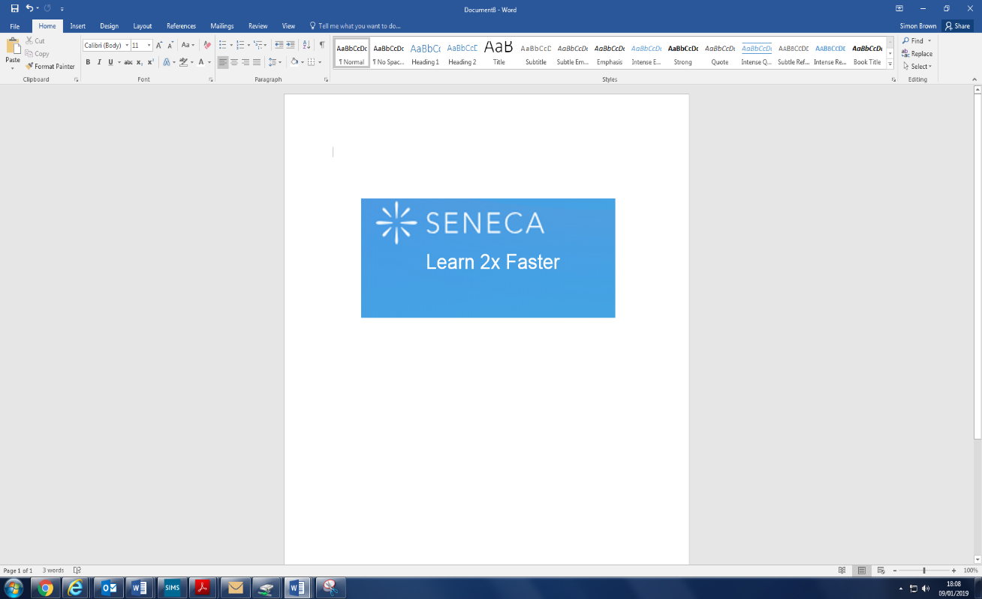








Learning Apps
Online Learning Apps
Many departments in the school have invested in online learning apps to take advantage of the excellent range of resources available to our students. These are extremely useful to build student’s knowledge which can allow them to get ahead, catch up or revise. Some apps enable students to access the course textbook at home (e.g. Kerboodle) which provides a useful resource when completing homework or revising. Others enable students to test themselves on knowledge to build their retention and prepare for assessments.
All Apps can be accessed by going through the Student Hub on the school website.
20

Slide 22
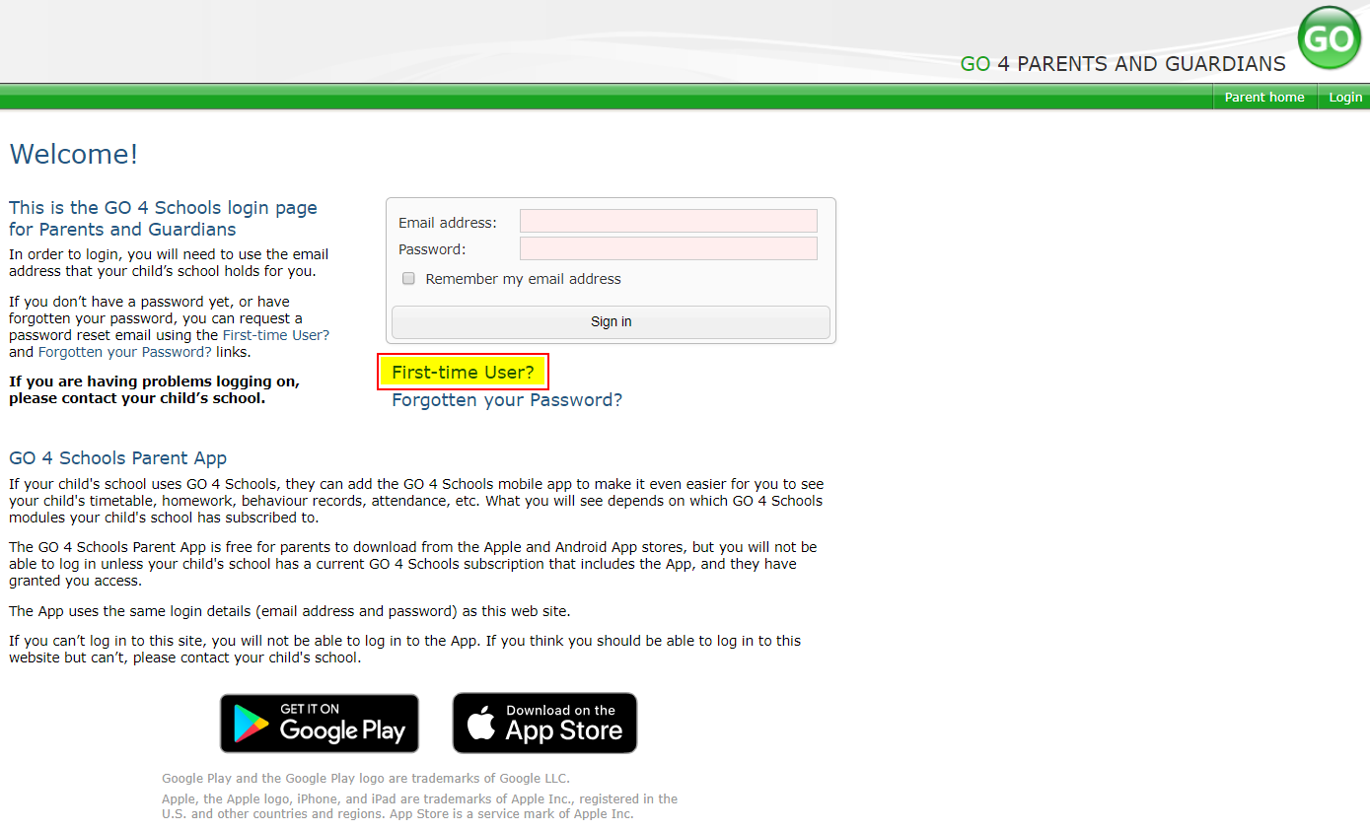
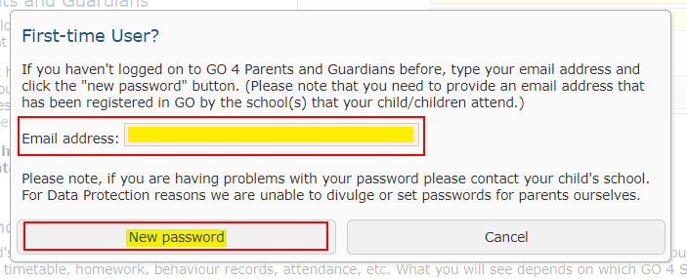
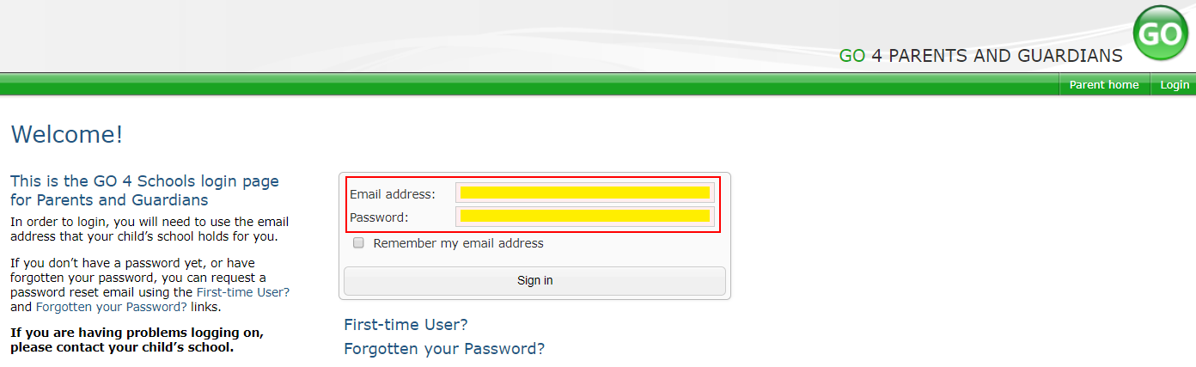
Go4Schools
Using GO 4 Schools, you will be able to view your child’s progress online and access the following information at any time:
Timetable – Your child’s daily and weekly timetable
Attendance – Shown from the start of the academic year
Progress Reports – Assessment point reports which are published 2 times a year
Behaviour information – A summary of positive and negative events, plus any managed detentions your child has been issued
Homework – Homework is set on Go4Schools and can be accessed by both parents and students via the app. Parents and students can easily see what homework has been set, when it is due and parents will also be able to track when the homework has been completed
Your child’s page is constantly updated, providing you with the latest information.
You will also have access to this information via a mobile app. Additional help documents for the Mobile App are available to parents and more information can be found at http://www.go4schools.com/MobileApp.aspx.
Accessing your Go 4 Schools Account
To access the site, please go to www.go4schools.com and click on the Parents icon at the top of the main page to arrive at the log-in screen. The email address you use to enter the site must be the one we have registered for you on our school system.
To request a password for GO 4 Schools, please click on the ‘First-time User’ link shown below.
Then enter your email address into the First-time User ‘Email address’ field and click ‘New password’. A randomised password will then be generated and sent to your email address.
You will then be able to log into the site using your email and generated password then view your child’s page using the parent and guardian login page, shown below.
21

Slide 23
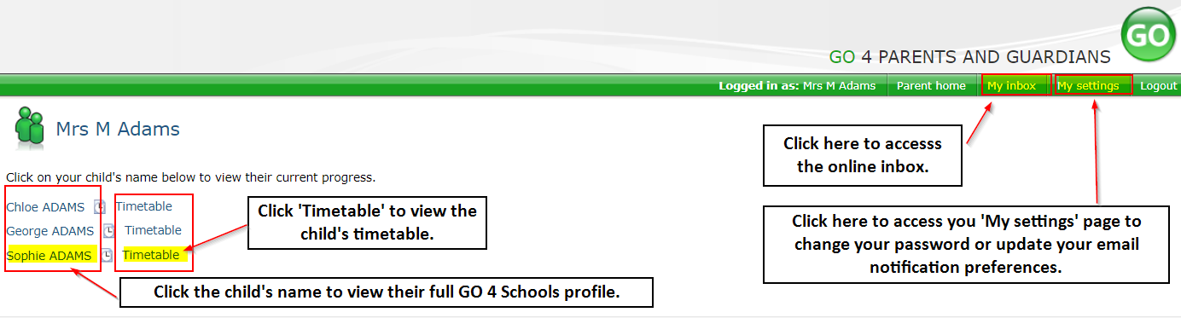
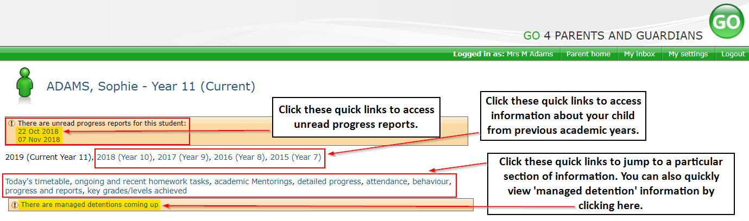
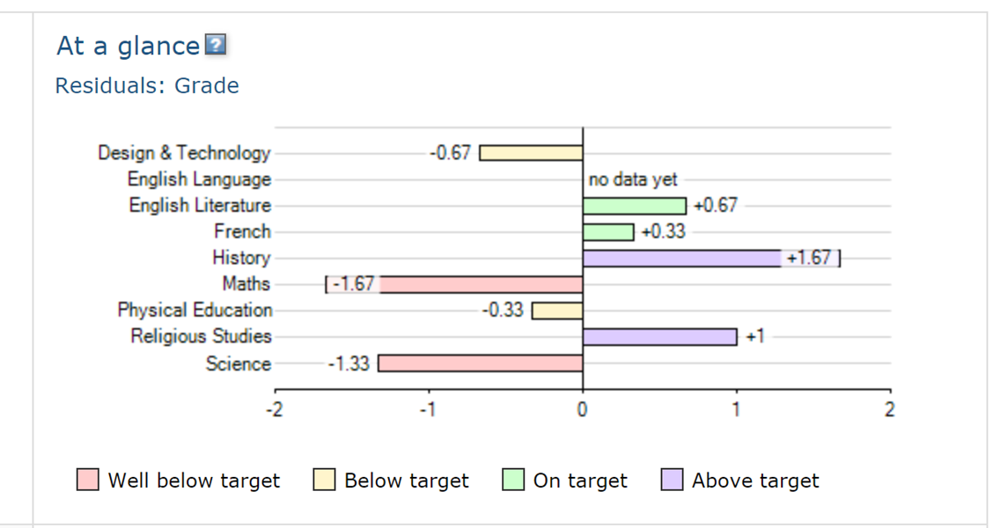
Go4Schools
Once logged in, what will you see?
At a glance
This is a quick overview of your child’s current progress against their target grades for each subject. A value of zero indicates that your child is on target, a negative value indicates below target and a positive value indicates above target
Parent home view
When you log in you will see names of your children that attend the school.
Clicking a child’s name will display the information held in GO 4 Schools about them. The top of the page give you these quick links.
22

Slide 24
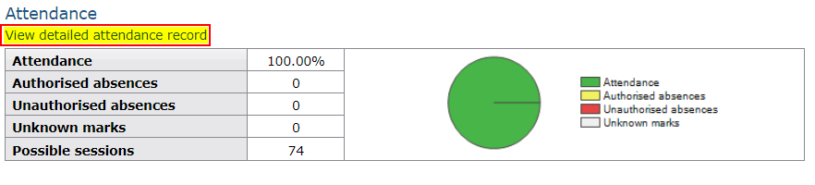
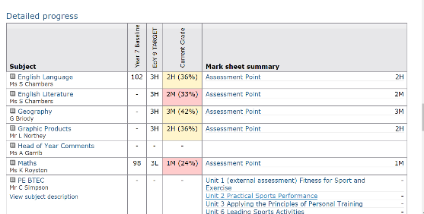
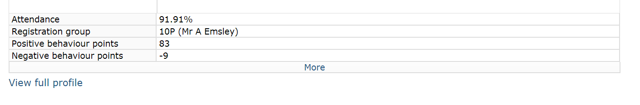
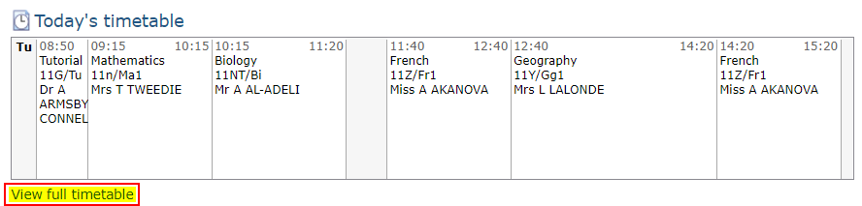
Go4Schools
Attendance Data
This information is always shown up to the previous day. Full attendance information, including weekly attendance figures, can be viewed by clicking the ‘view detailed attendance link’ shown in the yellow box.
Detailed Progress
This table shows the current levels in each subject. Also included is the target grade and colour coding to inform of progress.
Behaviour Data
This will give you an overview of positive and negative behaviour pointes.
Daily Timetable
You can click the ‘View full timetable’ link to view the full week timetable for your child or click for more detailed information on your child’s daily timetable including timings and teachers.
23

Slide 25
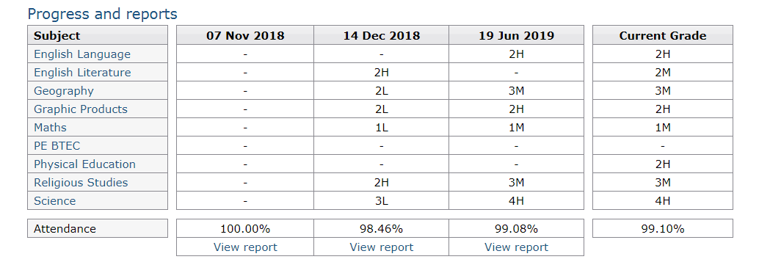
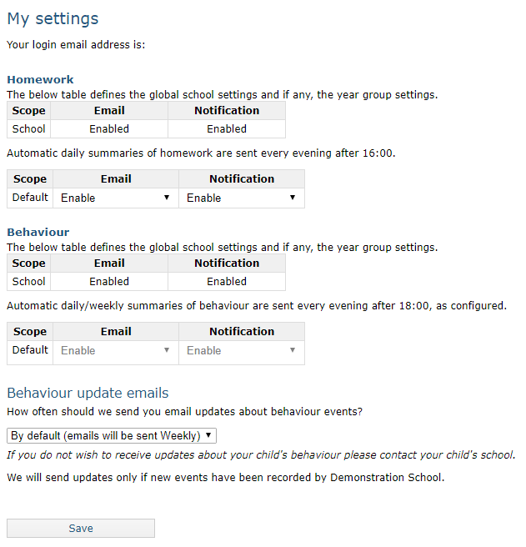
Go4Schools
Progress Reports
This shows grades for your child as they were captured by reports and compares them against current grades. At the bottom of each report column you can access a report by clicking the ‘View report’ link. You can then also download and print copies of the reports which will be available for the whole of the year.
Communication Settings
By clicking on “My settings” it will allow you to set whether you receive email notifications from GO 4 Schools, as well as show you the default setting the school has set.
24

Slide 26
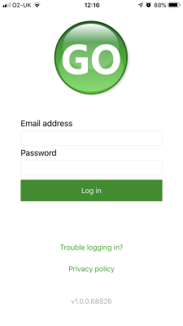
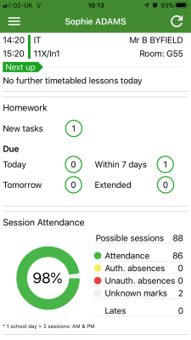
Go4Schools
How to log in to the App
Tap on the App to open.
Type in your email address and password. This is the same email address and password you use to log into the Go4Schools website.
Click on "log in". If you are a first-time user you will need to log into the website first to receive your password.
The homepage shows a student's current timetable and overview of the status of their homework. Tap on the timetable or homework to view more information.
25

Slide 27
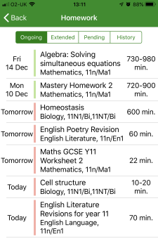
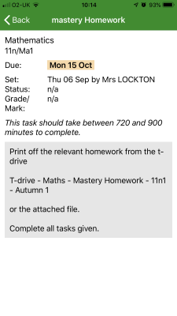
Go4Schools
How to view your child's homework
The homework card allows you to filter by ongoing, extended, pending, and homework history.
Tap on the specific homework you wish to view.
Detailed homework information is visible with attachments and weblinks. If the school tracks homework you can see when a class teacher has ticked off the completion of Homework tasks or marks if the work has been assessed.
26

Slide 28
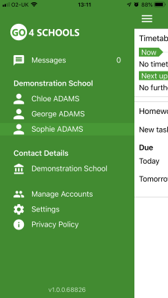
Go4Schools
How to view your messages
Tap on the menu in the top-left corner to access messages and settings.
From the menu you can view messages, or swap between schools and select individual students with GO 4 Schools accounts. Your settings can also be accessed from this menu.
27

Slide 29
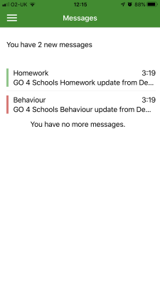
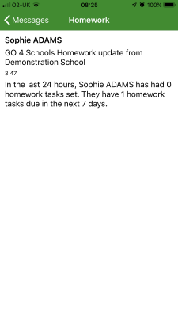
Go4Schools
How to view your messages
In the message inbox tap on the message for more detail. Your messages will be organised by date order and titled by areas such as Homework and Behaviour.
Tap back on messages and then your child's name to return to the main screen.
28

Slide 30
Go4Schools
How to view your child's attendance
The attendance information is displayed on the main App page and shows the overall percentage attendance as a chart with details for authorised and unauthorised absence including a count of late marks. Where an unknown mark is displayed this may be due to the school waiting for confirmation for the reason of the absence.
29

Slide 31
Notes
30

Slide 32
Notes
31

